Slide 1
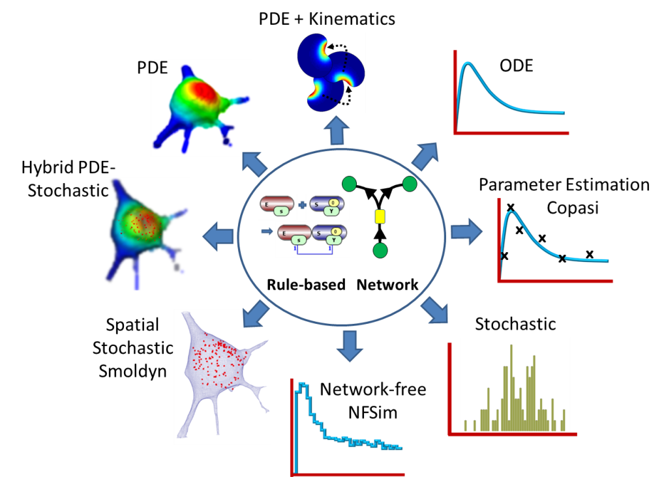

VCell
A modeling environment for the simulation of cellular events. Download at vcell.org .
Virtual Cell is developed by the Center for Cell Analysis and Modeling at the University of Connecticut Health Center. It is funded as a Biomedical Technology Research Resource by the National Institute of General Medical Sciences (NIGMS)

Slide 2
VCell BioModel using the Moving Boundary Solver
Objective
Create a simple Biomodel of a fluorescence photobleaching (FRAP) experiment in a moving cell; learn how to specify kinematics in a VCell Biomodel and utilize the Moving Boundary solver.
Goals
Create a Biomodel Physiology that recreates a fluoresence photobleaching experiment and a spatial deterministic application of the Physiology using a 2D geometry created from analytic expressions for a simple circle
Specify kinematics (i.e. velocities) of structures and the molecules contained within the structures
Define initial conditions that vary in x and y using Boolean expressions.
Create a simulation using the VCell Moving Boundary solver, specifying time course and computational mesh.
Run the simulation, view and export results.

Slide 3
Notes on the VCell Moving Boundary Solver
Moving Boundary Applications in VCell allow for PDE (spatial) simulations to occur within a geometry where the boundaries of compartments can change in shape and position within the overall computational space. There are some important things to keep in mind when you create this type of application.
The current implementation of the moving boundary solver only works with 2D geometries. We hope in the future to enable problems with 3D geometries.
Creating an application with a moving boundary solver follows the same steps used for fixed domains, except that a velocity is assigned to points on the cell membrane (and optionally for species residing with the volume) by defining Kinematics for surface and volume objects as part of the description of the Geometry.
Species will have both diffusion terms (which can be 0) and velocity terms defined by the kinematics. Because displacement terms will be different in different compartments, species in different compartments will not necessarily move together. This tutorial provides an example of different types of kinematics for membranes and volumes.
Currently, VCell tools for analyzing spatial results are not available for results of moving boundary simulations, so it is necessary to export your results to other image processing software to analyze the results of simulations.

Slide 4
Table of contents
Opening VCell
Using VCell Help
Defining compartments
Creating species
Creating applications
Creating a 2D geometry using algebraic expressions
Editing computational domain size
Mapping geometry to compartments
Specifying kinematic processes.
Specifying initial conditions
Creating a simulation
Using the Moving Boundary Solver
Viewing simulation results
Export simulation results as an NRRD or HDF5 file
Export simulation results as a Quicktime movie
Modify the model to see how volume species react to membrane changes

Slide 5
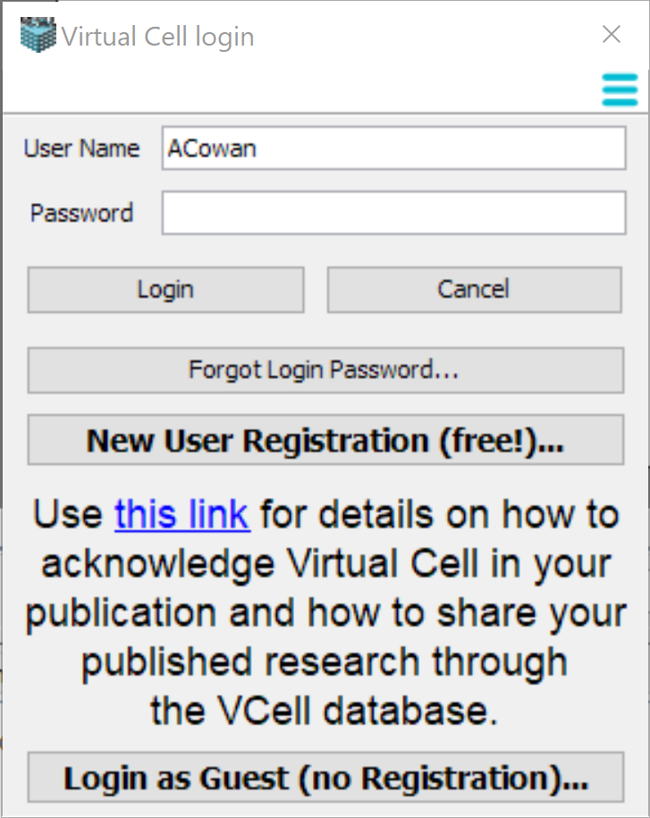
Your first time opening VCell
You need to register as a New User if you want to run simulations on the VCell compute resources, or use the VCell database to store models that can be shared with collaborators.

Slide 6
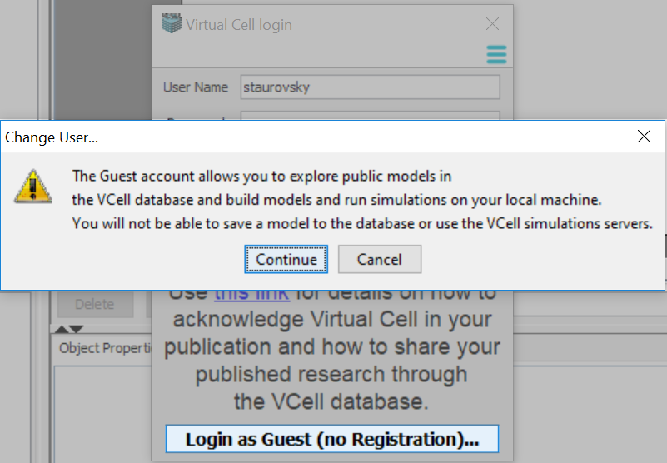
Your first time opening VCell Guest Login Option

Slide 7
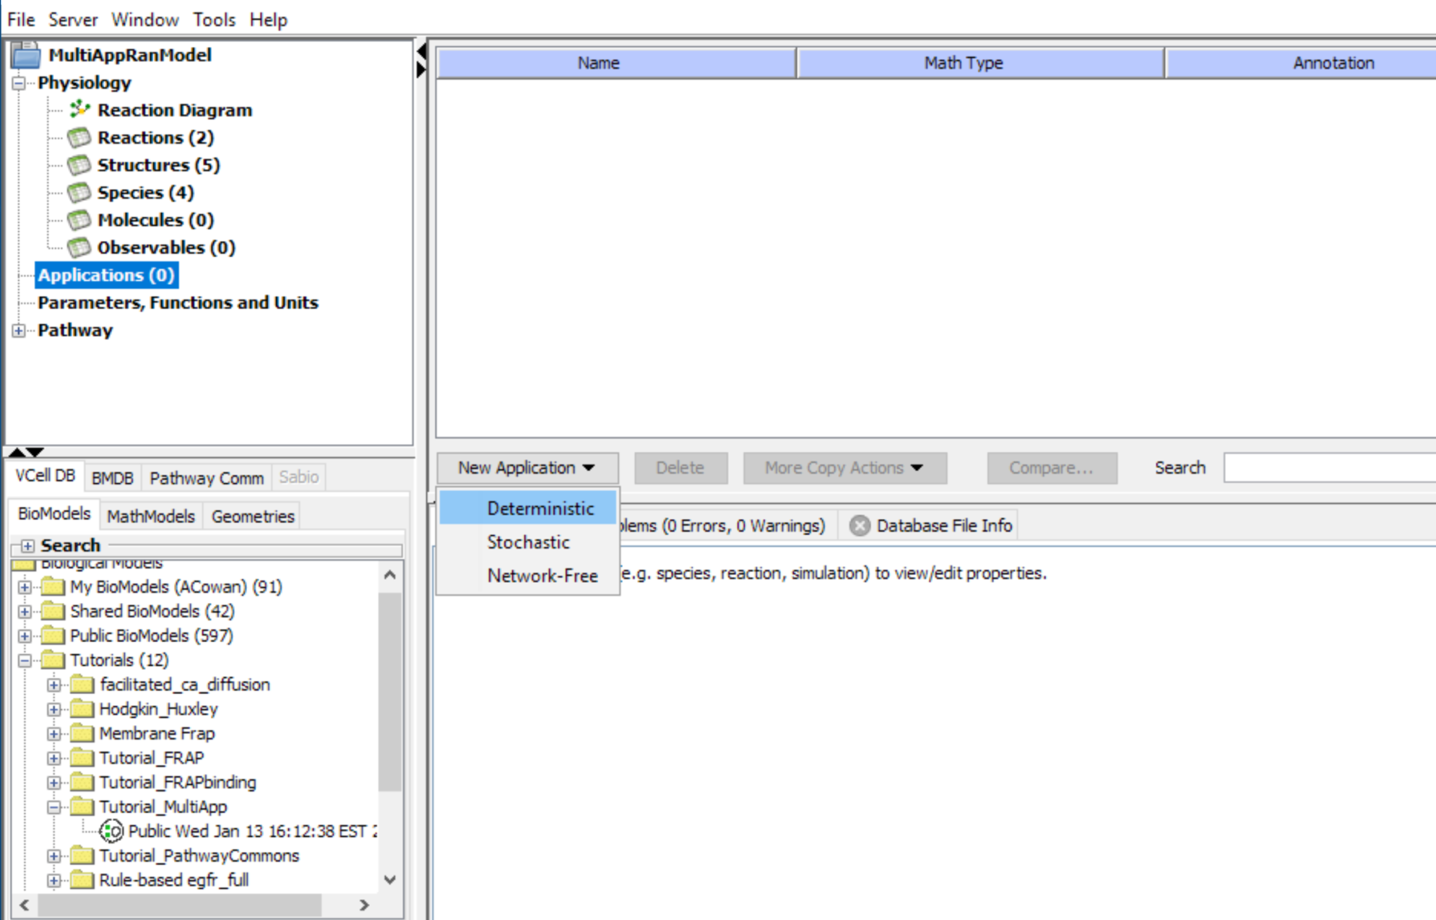
VCell BioModel Organization
BioModel
Physiological representation of the model where the compartments, molecules, biochemical reactions and kinetic parameters are defined.
Applications
There may be one or multiple applications within one BioModel. Here, simulation-dependent conditions are defined, such as initial conditions, simulation specific details, and changes in kinetic parameters.
Simulations
Execution of BioModel Application with defined length of time, time step, resolution, solver and parameter overrides.

Slide 8
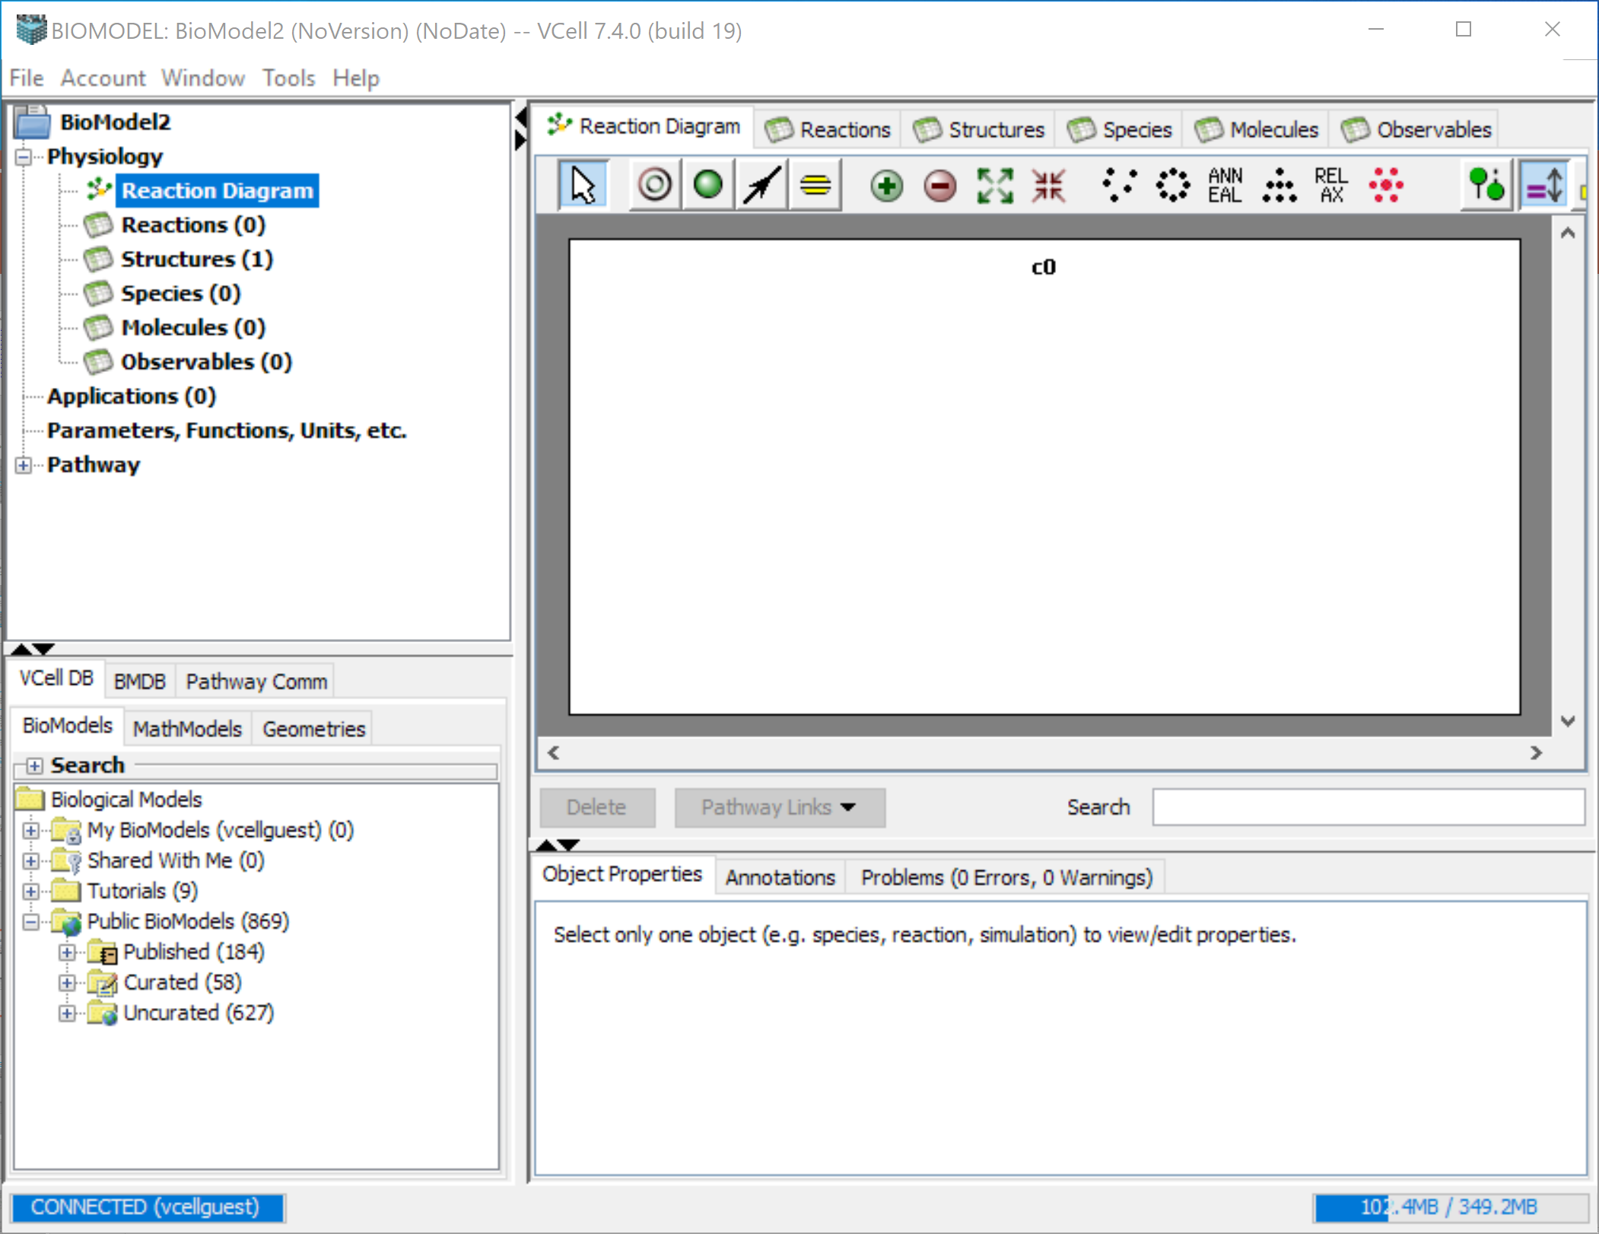
The VCell Interface

Slide 9
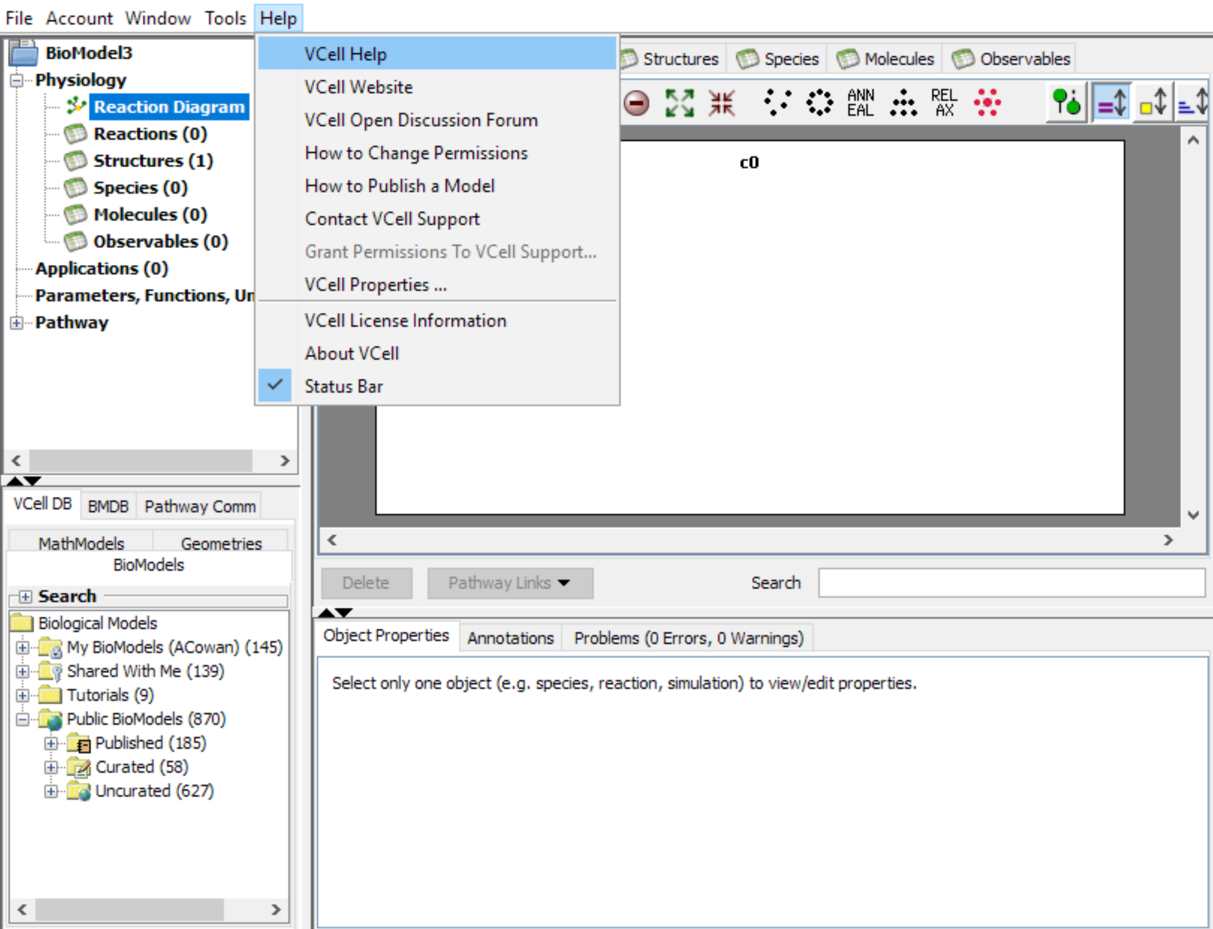
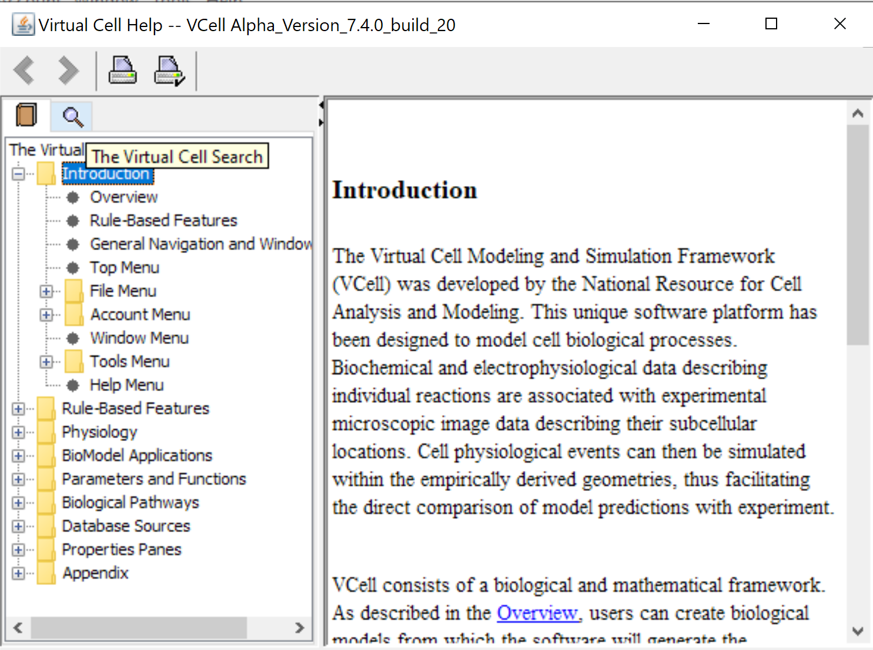
An extensive, searchable, help guide is available from the Help Menu

Slide 10
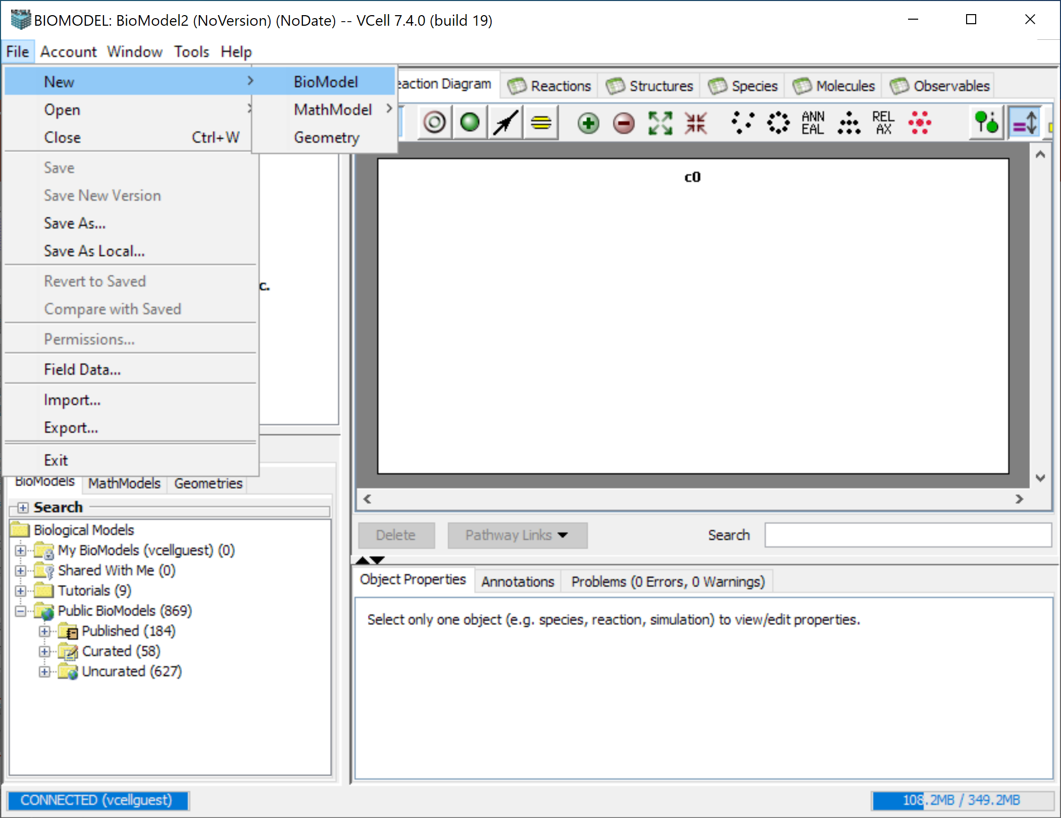
To create a new VCell model, click “File” > “New” > “BioModel”

Slide 11
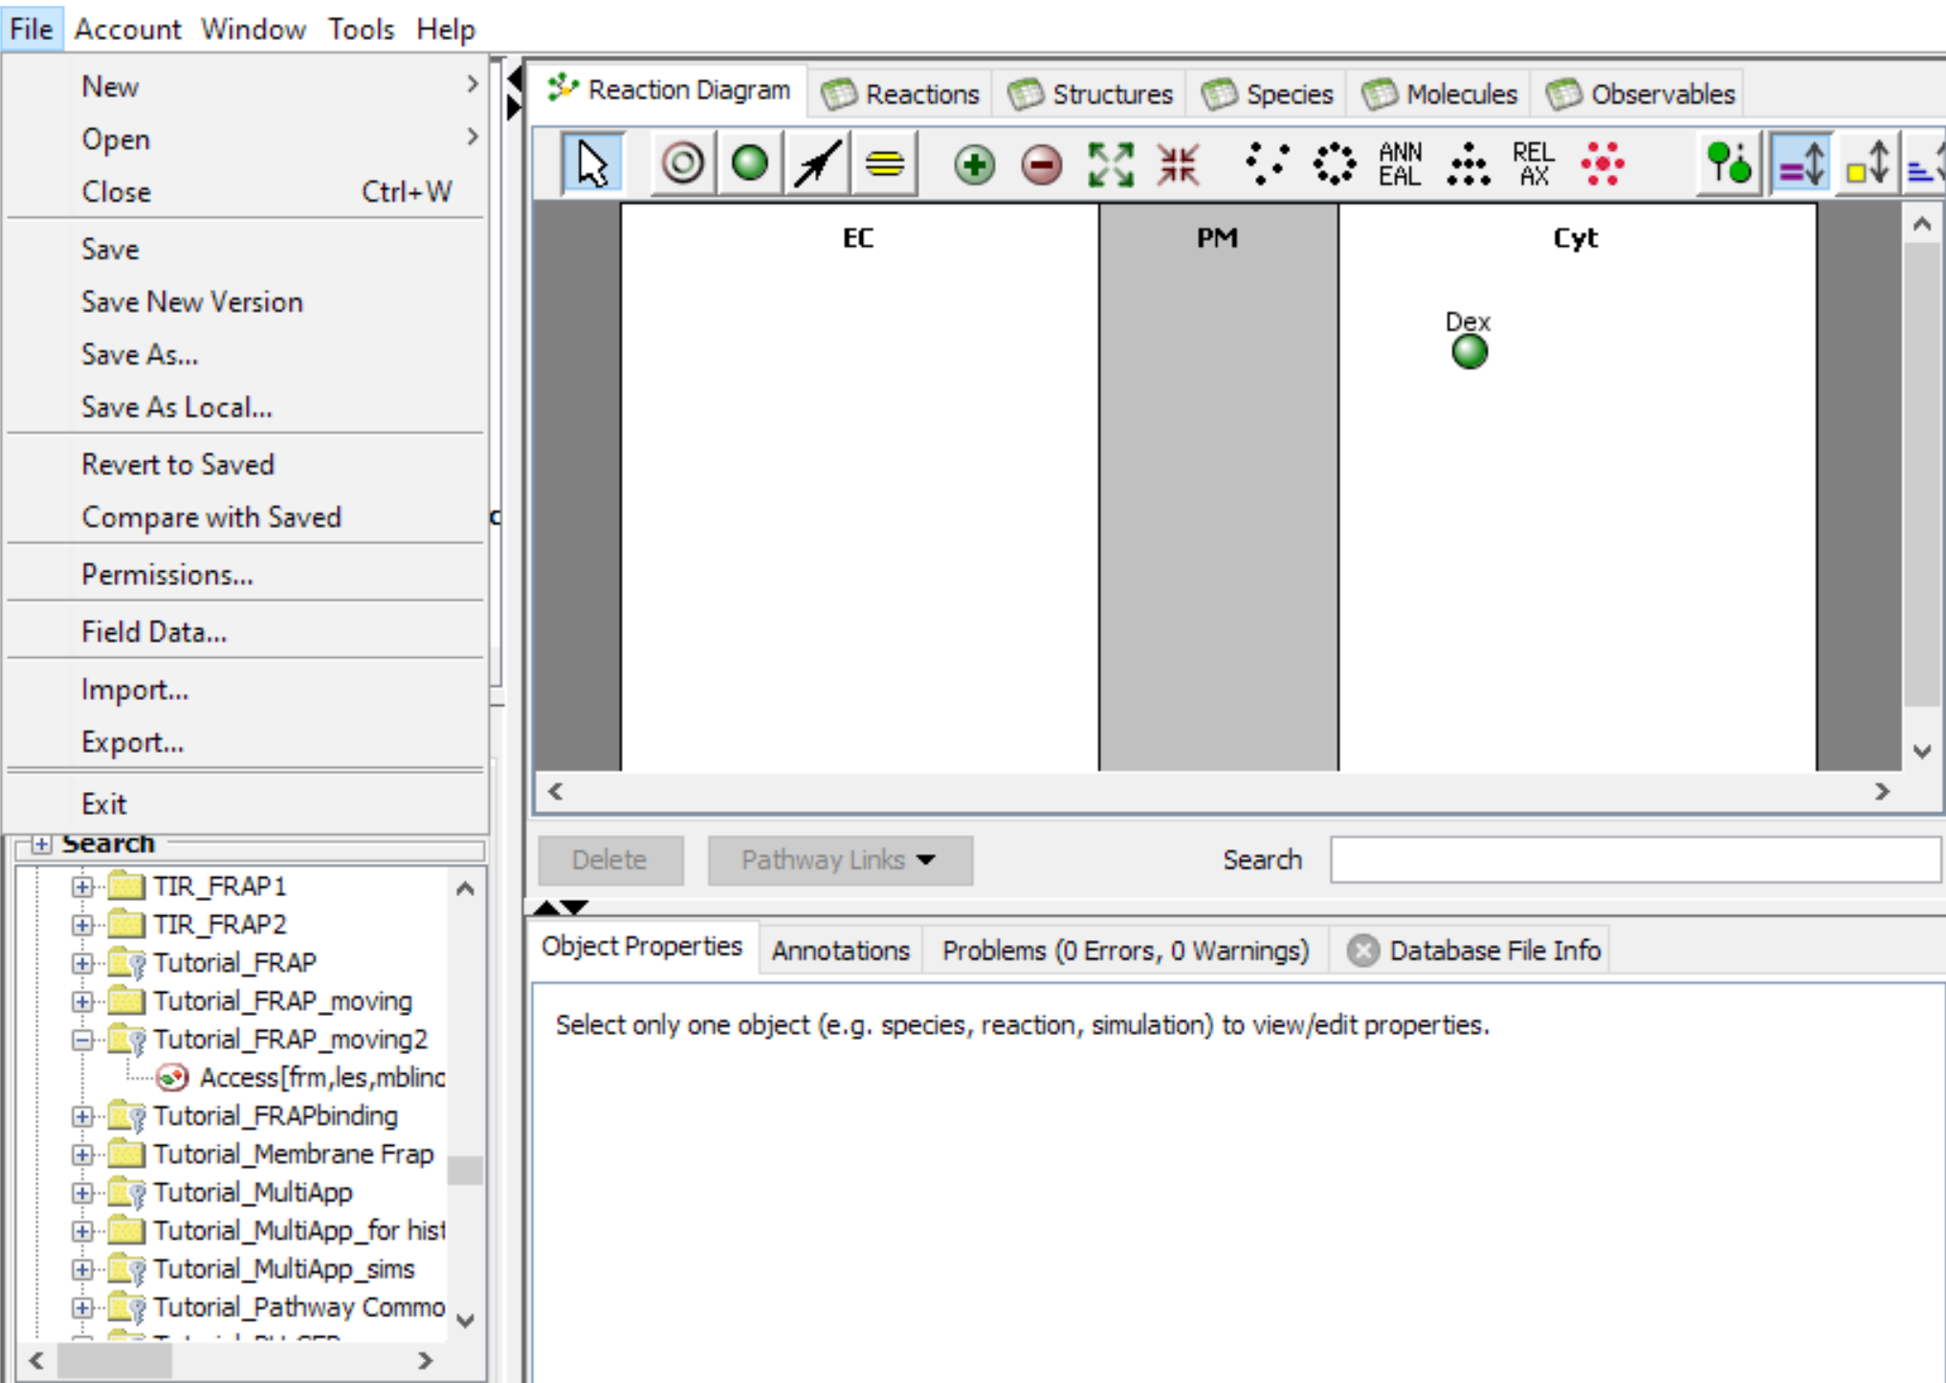
To save your model, navigate to “File” and make your selection from the four “Save” options that are available.
Tip: “Save as Local” saves a VCML file to the local machine, and can be used if you are disconnected from the server when building a model

Slide 12
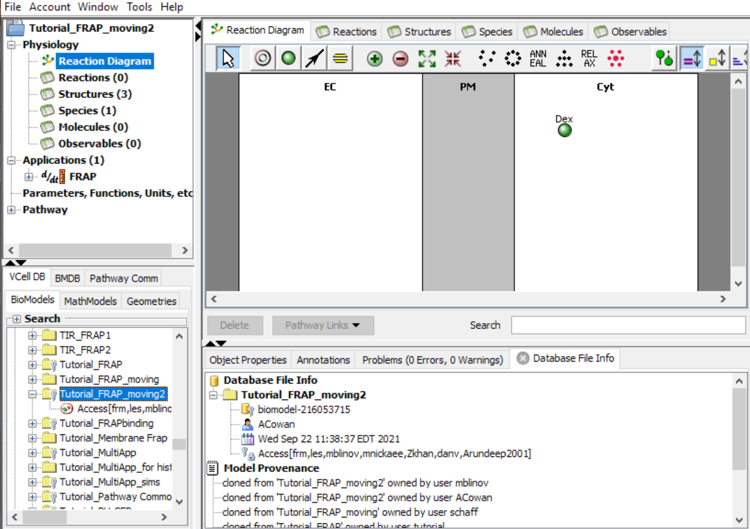
To re-open a model, navigate to the folder that the model was saved in and double-click the model name.
Tip: When click on a model in the database window, Annotations about the model appear in the properties pane here.

Slide 13
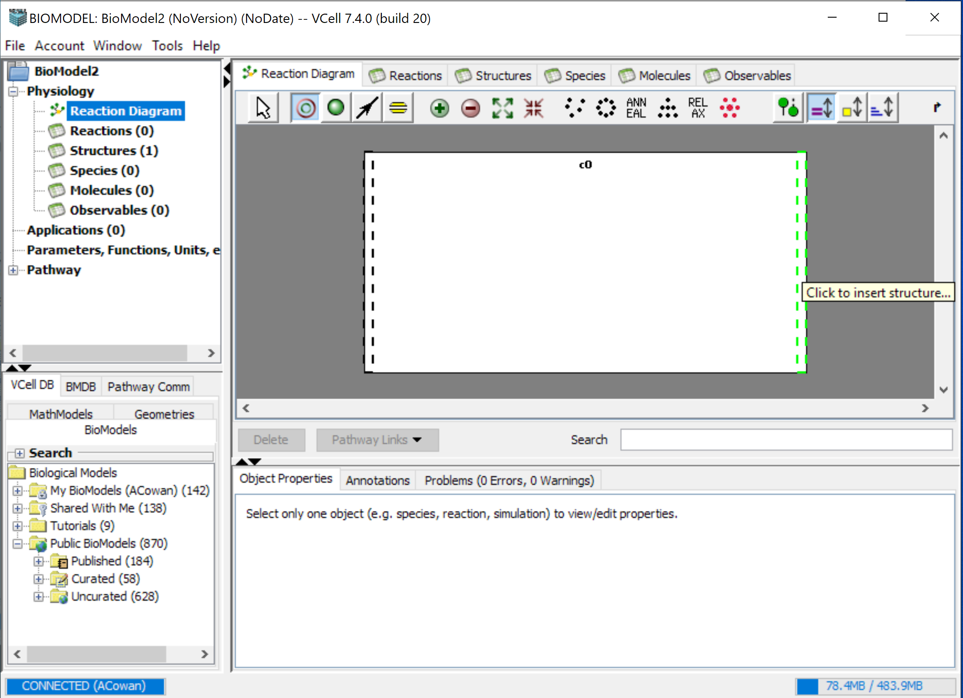
To create the components to your model, start with creating a volumetric compartment by selecting the Structure Tool. This will automatically create your first compartment.
To create a new membrane, click on one of the black lines so they turn green, and select “Add Membrane”.

Slide 14
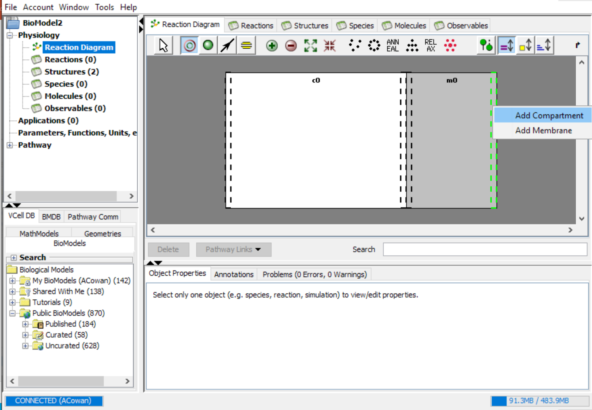
To create a new compartment, click on the dotted black lines, which will become green, and select “Add Compartment”.

Slide 15
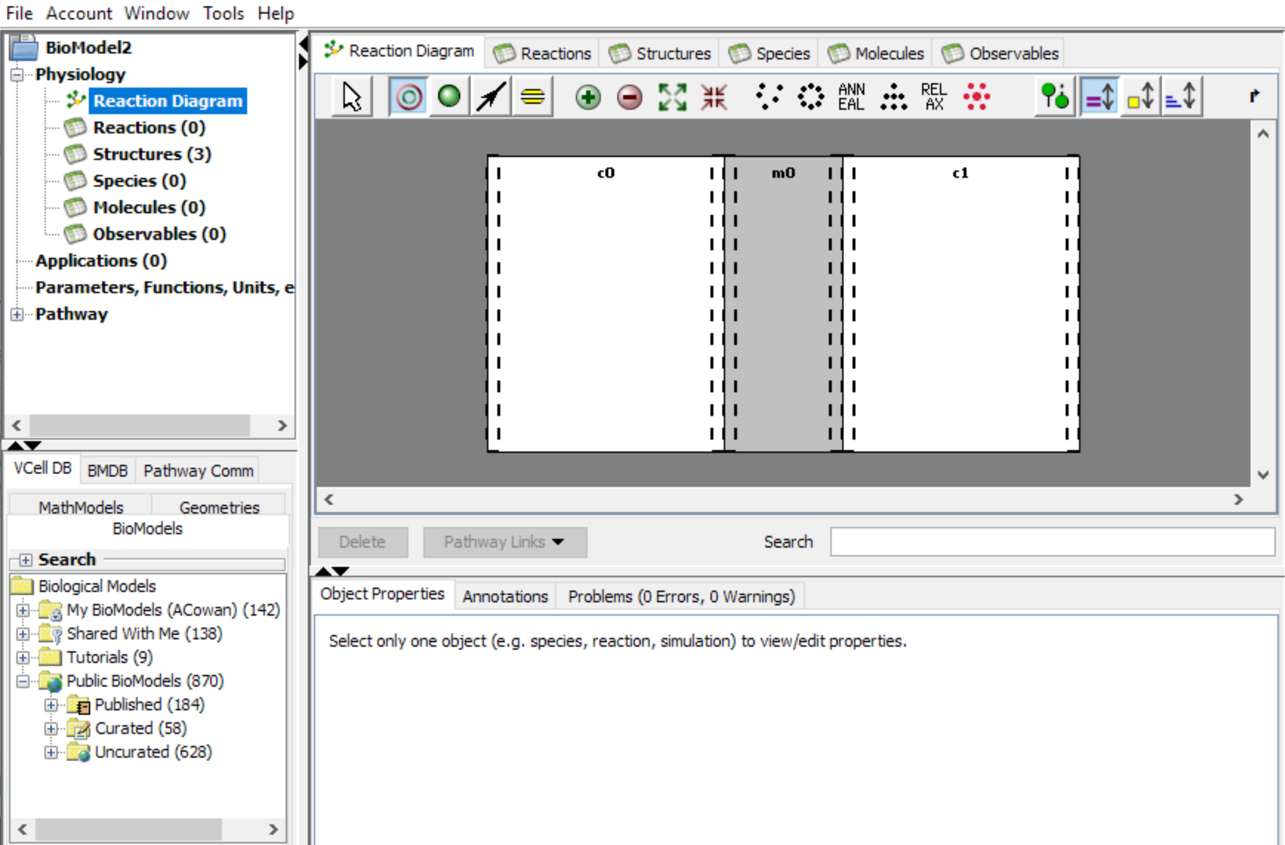

Your model requires 2 volumetric compartments separated by a membrane compartment.
If you need to rearrange compartments and membranes, or any other features, use the selection tool and drag them by their label.

Slide 16
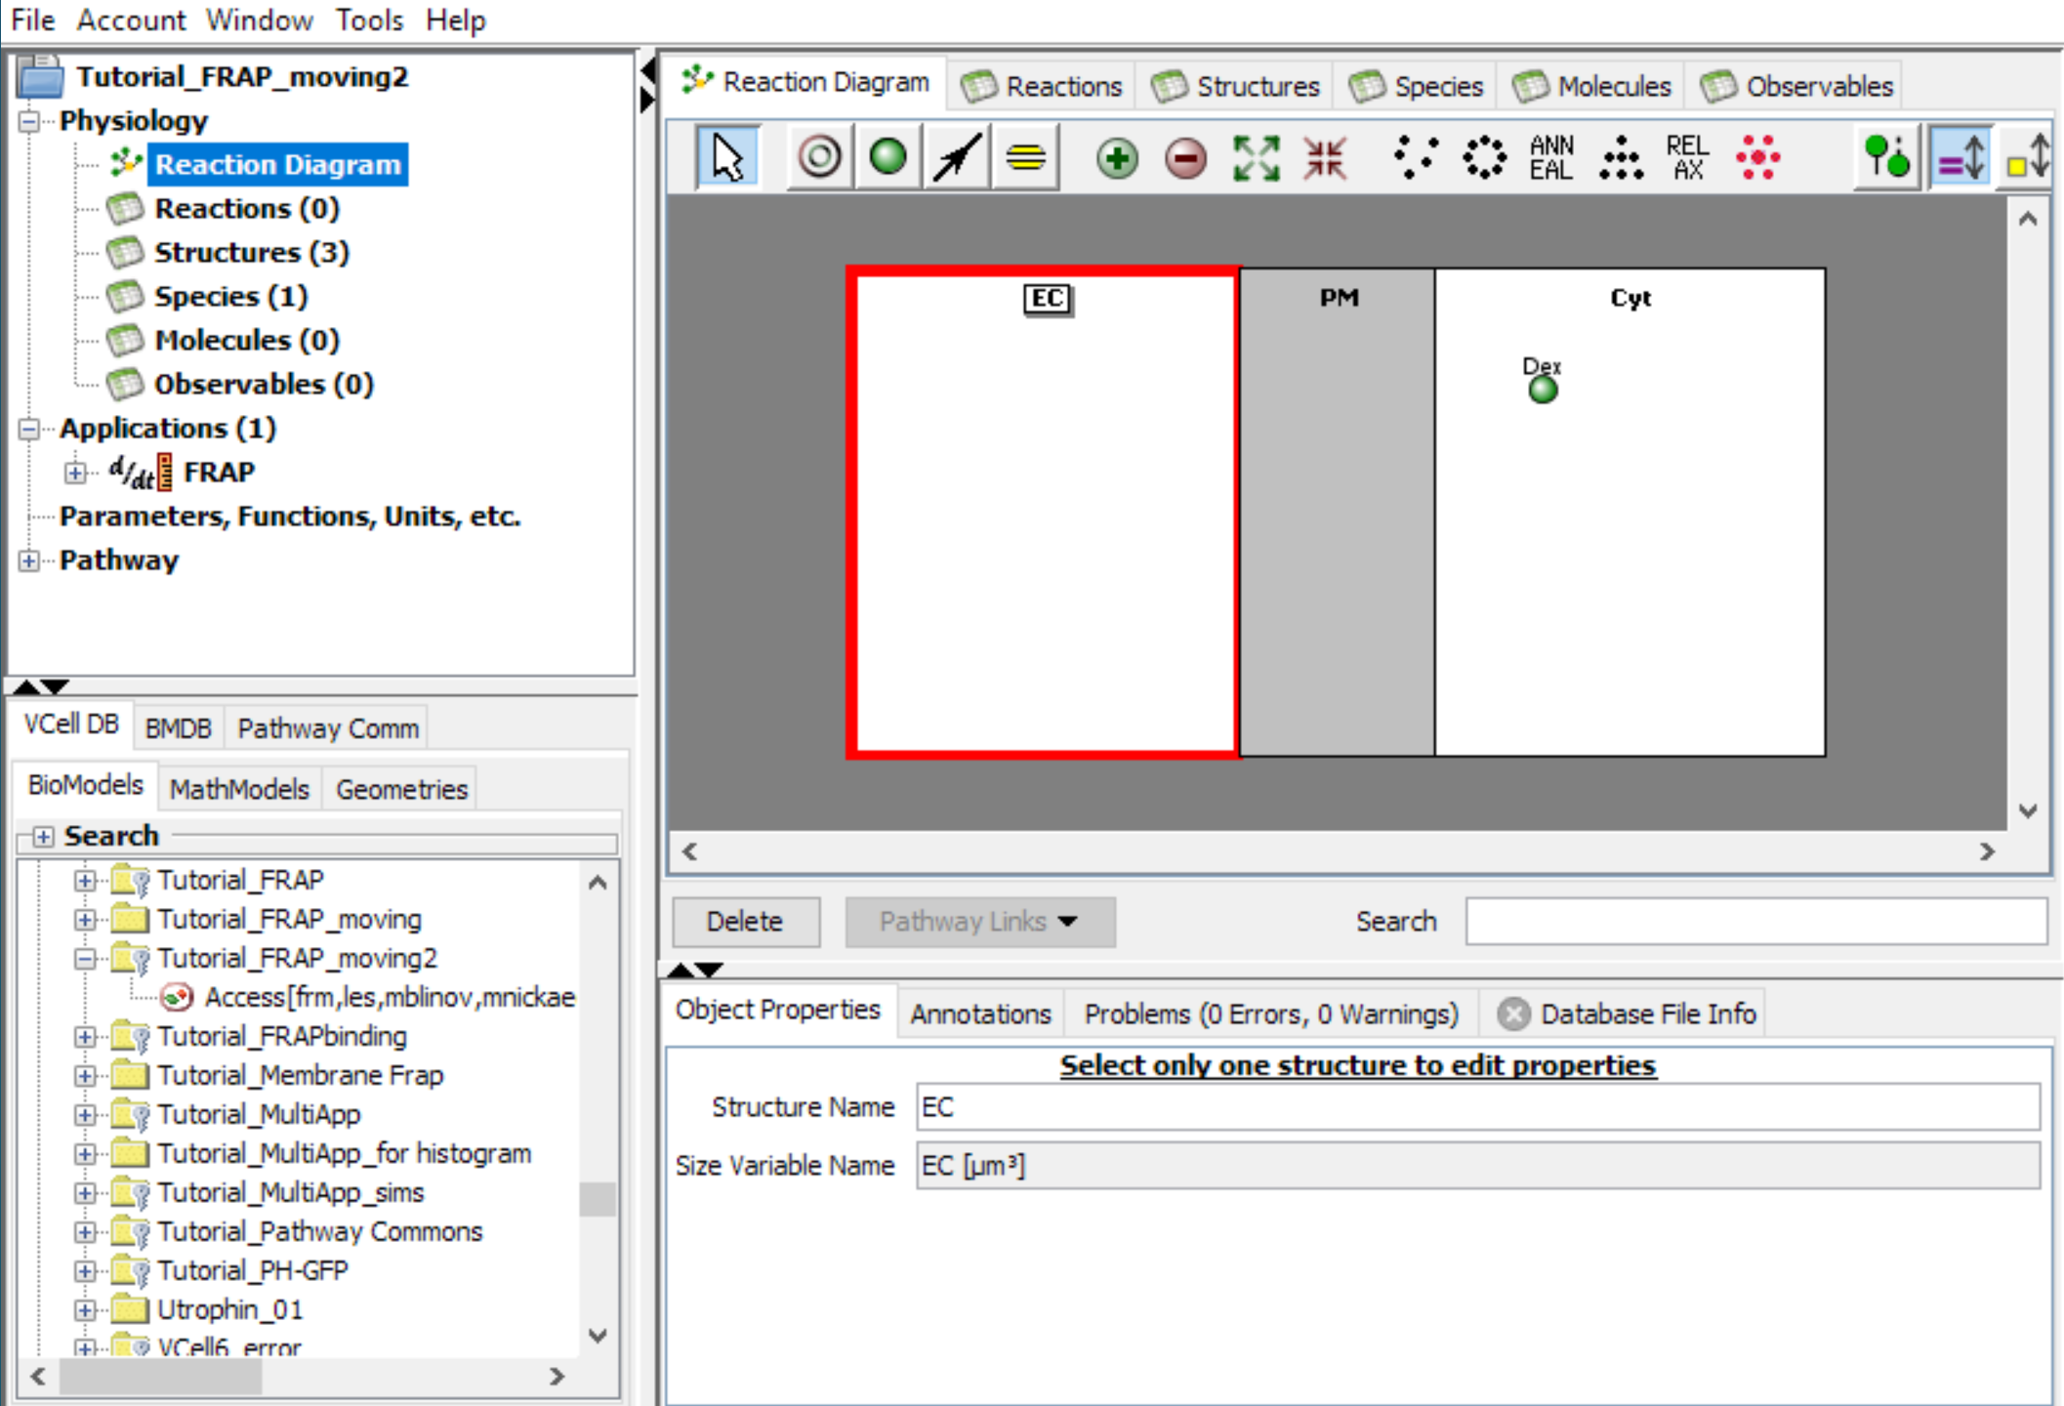
Use the selection tool to name compartments and membranes. The area will turn red upon selection. Double click the structure name you wish to change and enter the new name.

Slide 17
You can also change the Structure Name on the Object Properties tab.
You can annotate compartments and rename species here as well.
The volume compartments in this tutorial are EC and Cyt, separated by a membrane, PM

Slide 18
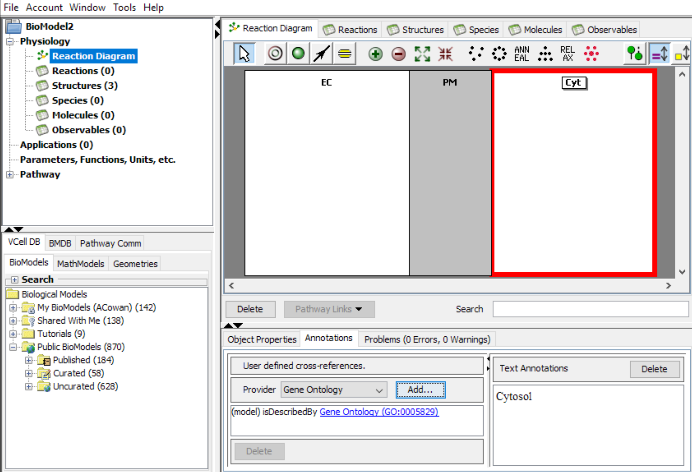
Use the Annotations tab in the Properties pane to add either unique identifiers or text annotations for any model component.

Slide 19
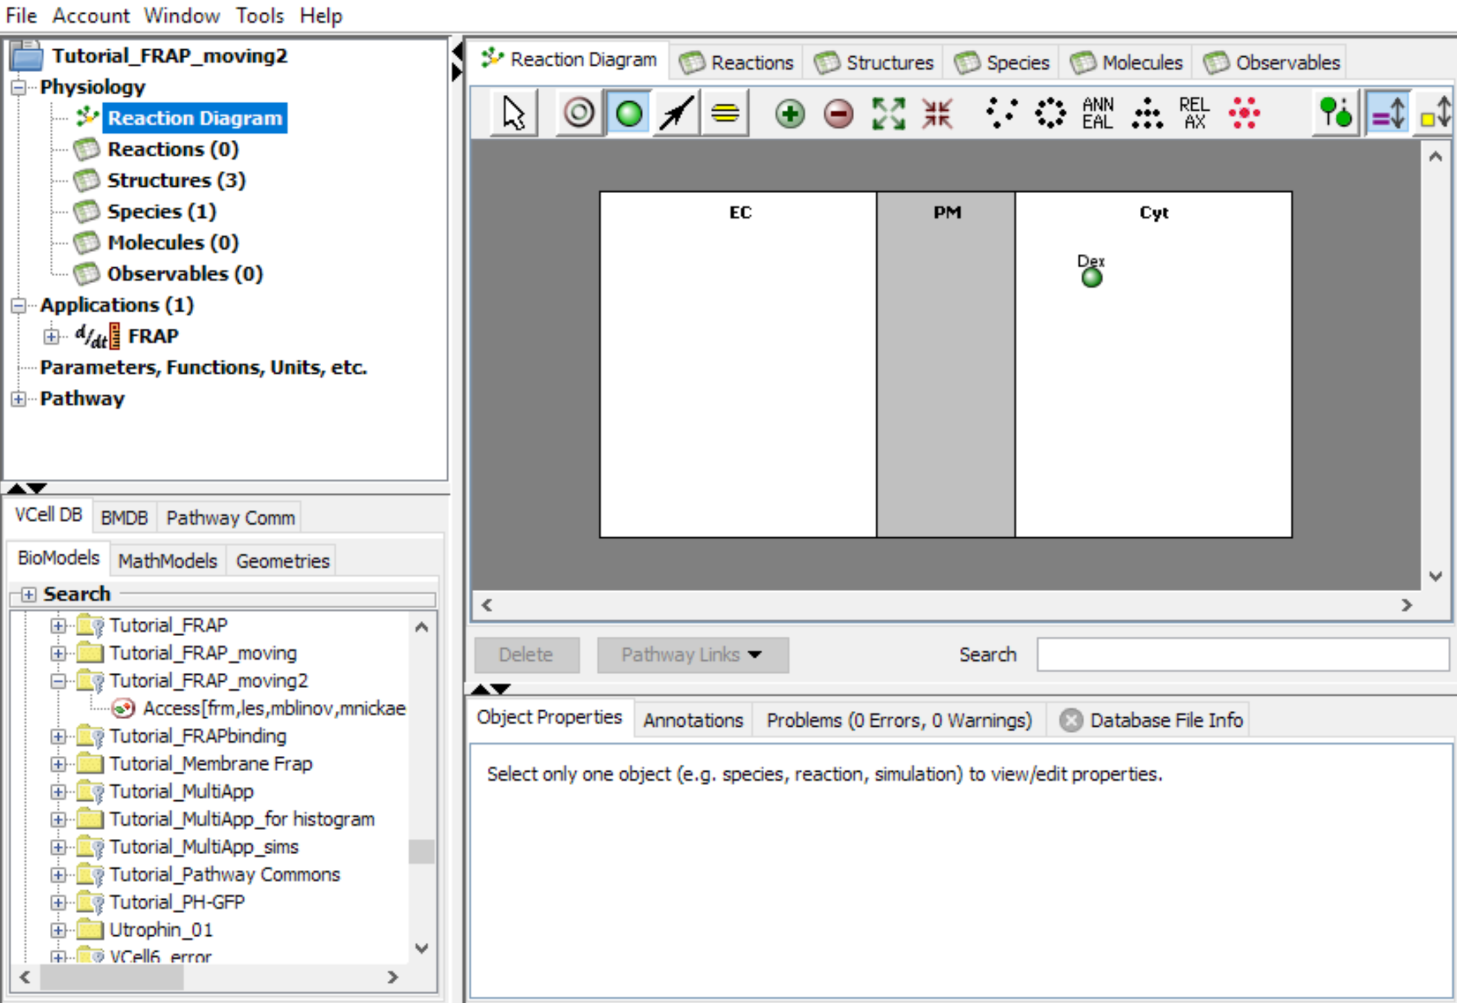
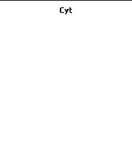

To add a species to the model, click on the species tool, then click in the area you want to place the species.
Species – are molecules, compounds or states thereof.

Slide 20
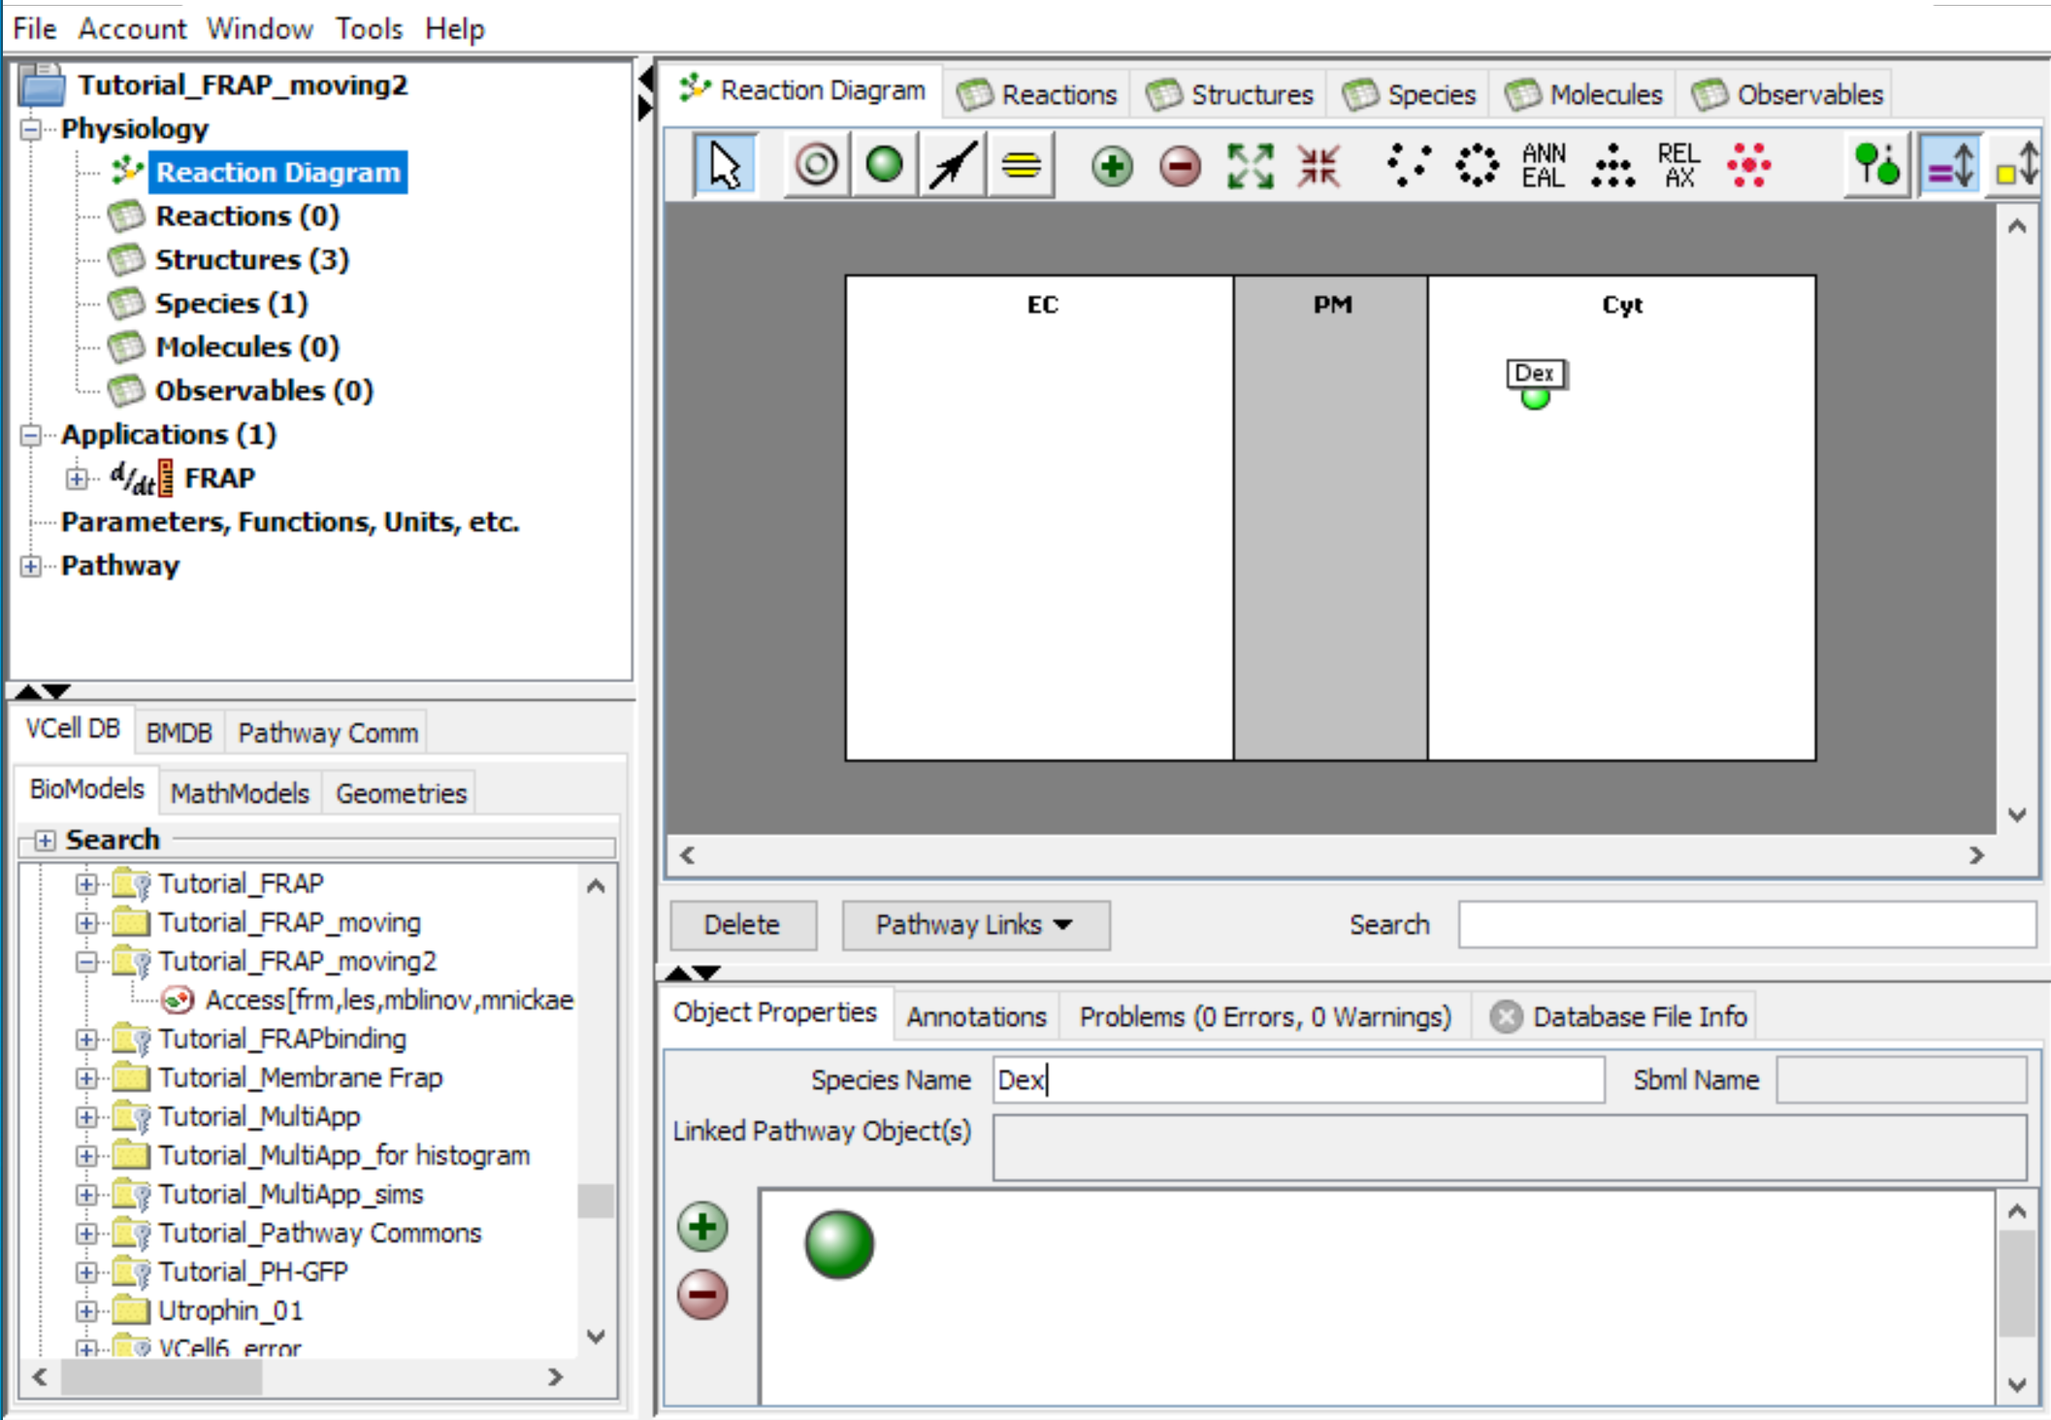
This tutorial uses only a single diffusing species (“Dex” for fluorescently labelled dextran) that will be photobleached in a moving cell.
Look at other tutorials to see how to create reactions among species.

Slide 21
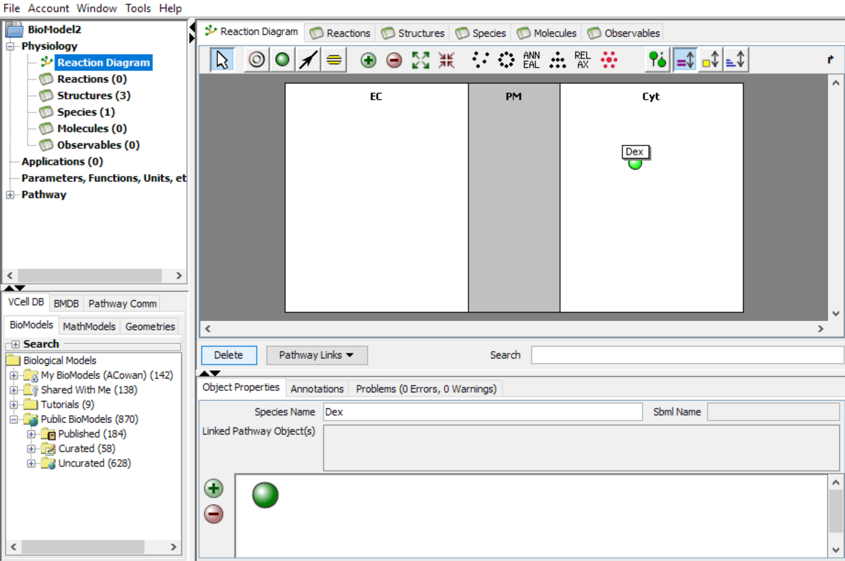
To remove a species or reaction from your model, select the species or reaction and click on either the “Delete” button or the backspace button on your keyboard.
Note that you cannot move species, reactions, or fluxes from one compartment to another. You must delete a species, flux, or reaction from one compartment and then create it in another compartment.

Slide 22
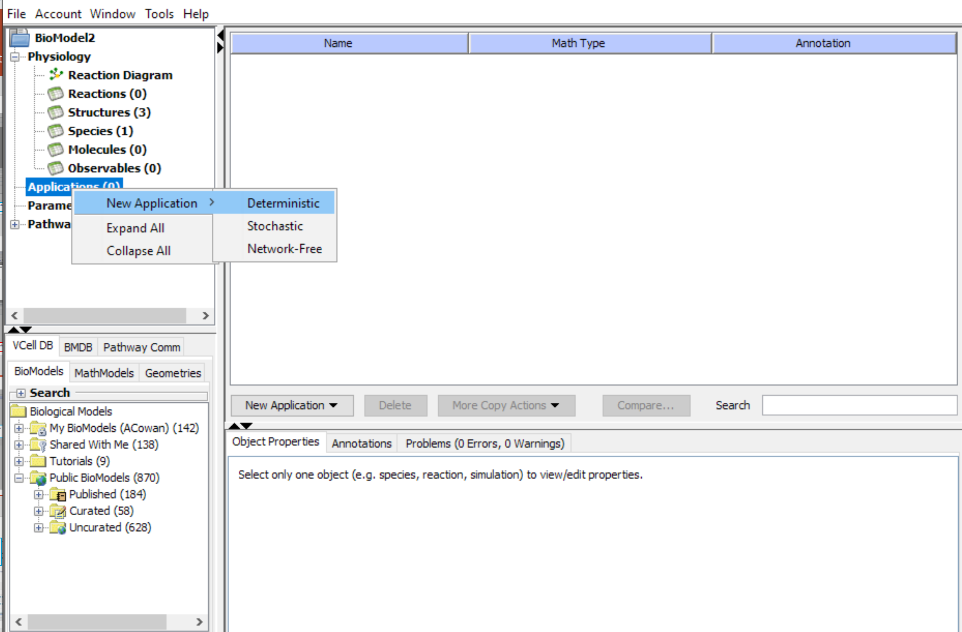
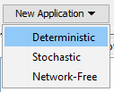
To create an “Application”, select Application and then right click and select “New Application” > Deterministic, Stochastic, or Network-Free.
Alternatively, select New Application from the drop down menu and choose from Deterministic, Stochastic, or Network-Free.
To use the moving boundary solver, create a Deterministic Application.

Slide 23
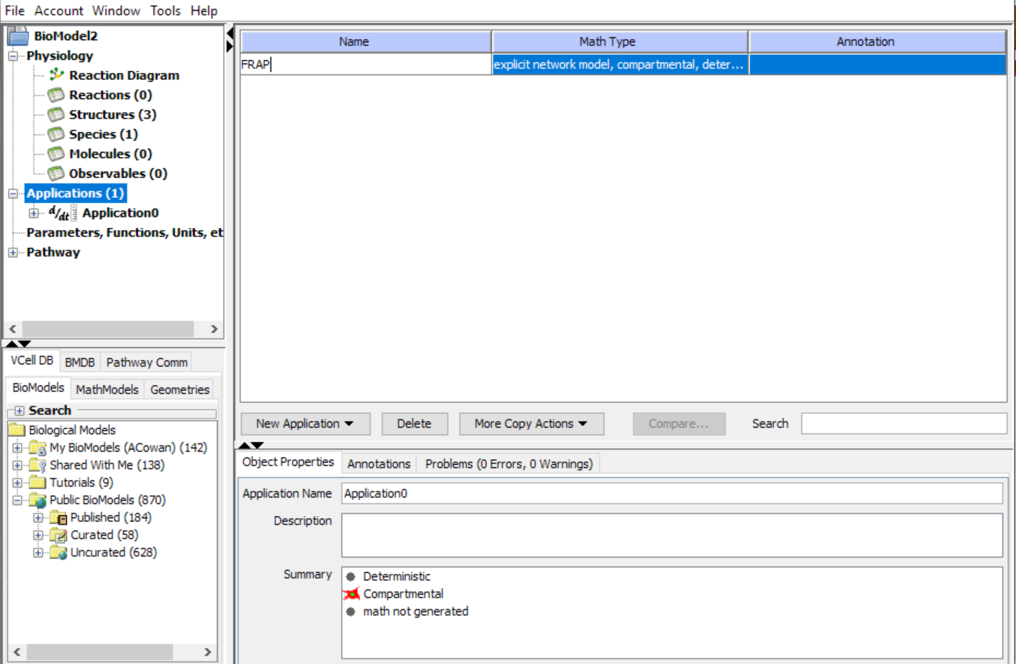
Double click on the name box and rename the application as “FRAP”. Press “Enter” on your keyboard to finalize.

Slide 24
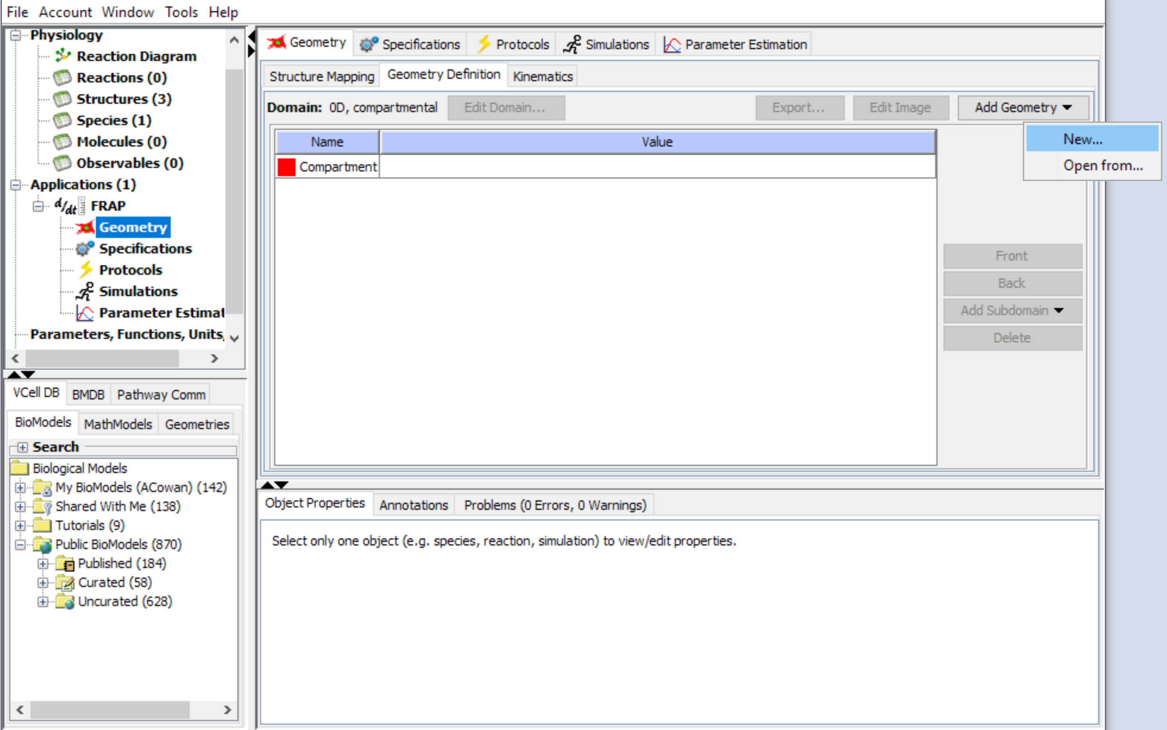
Once you have created an “Application”, expand the submenu and select the Application you are working with. When an “Application” is selected, the “Geometry Definition” tab will be accessible. From there, navigate to “Add Geometry” and create a “New” geometry.

Slide 25
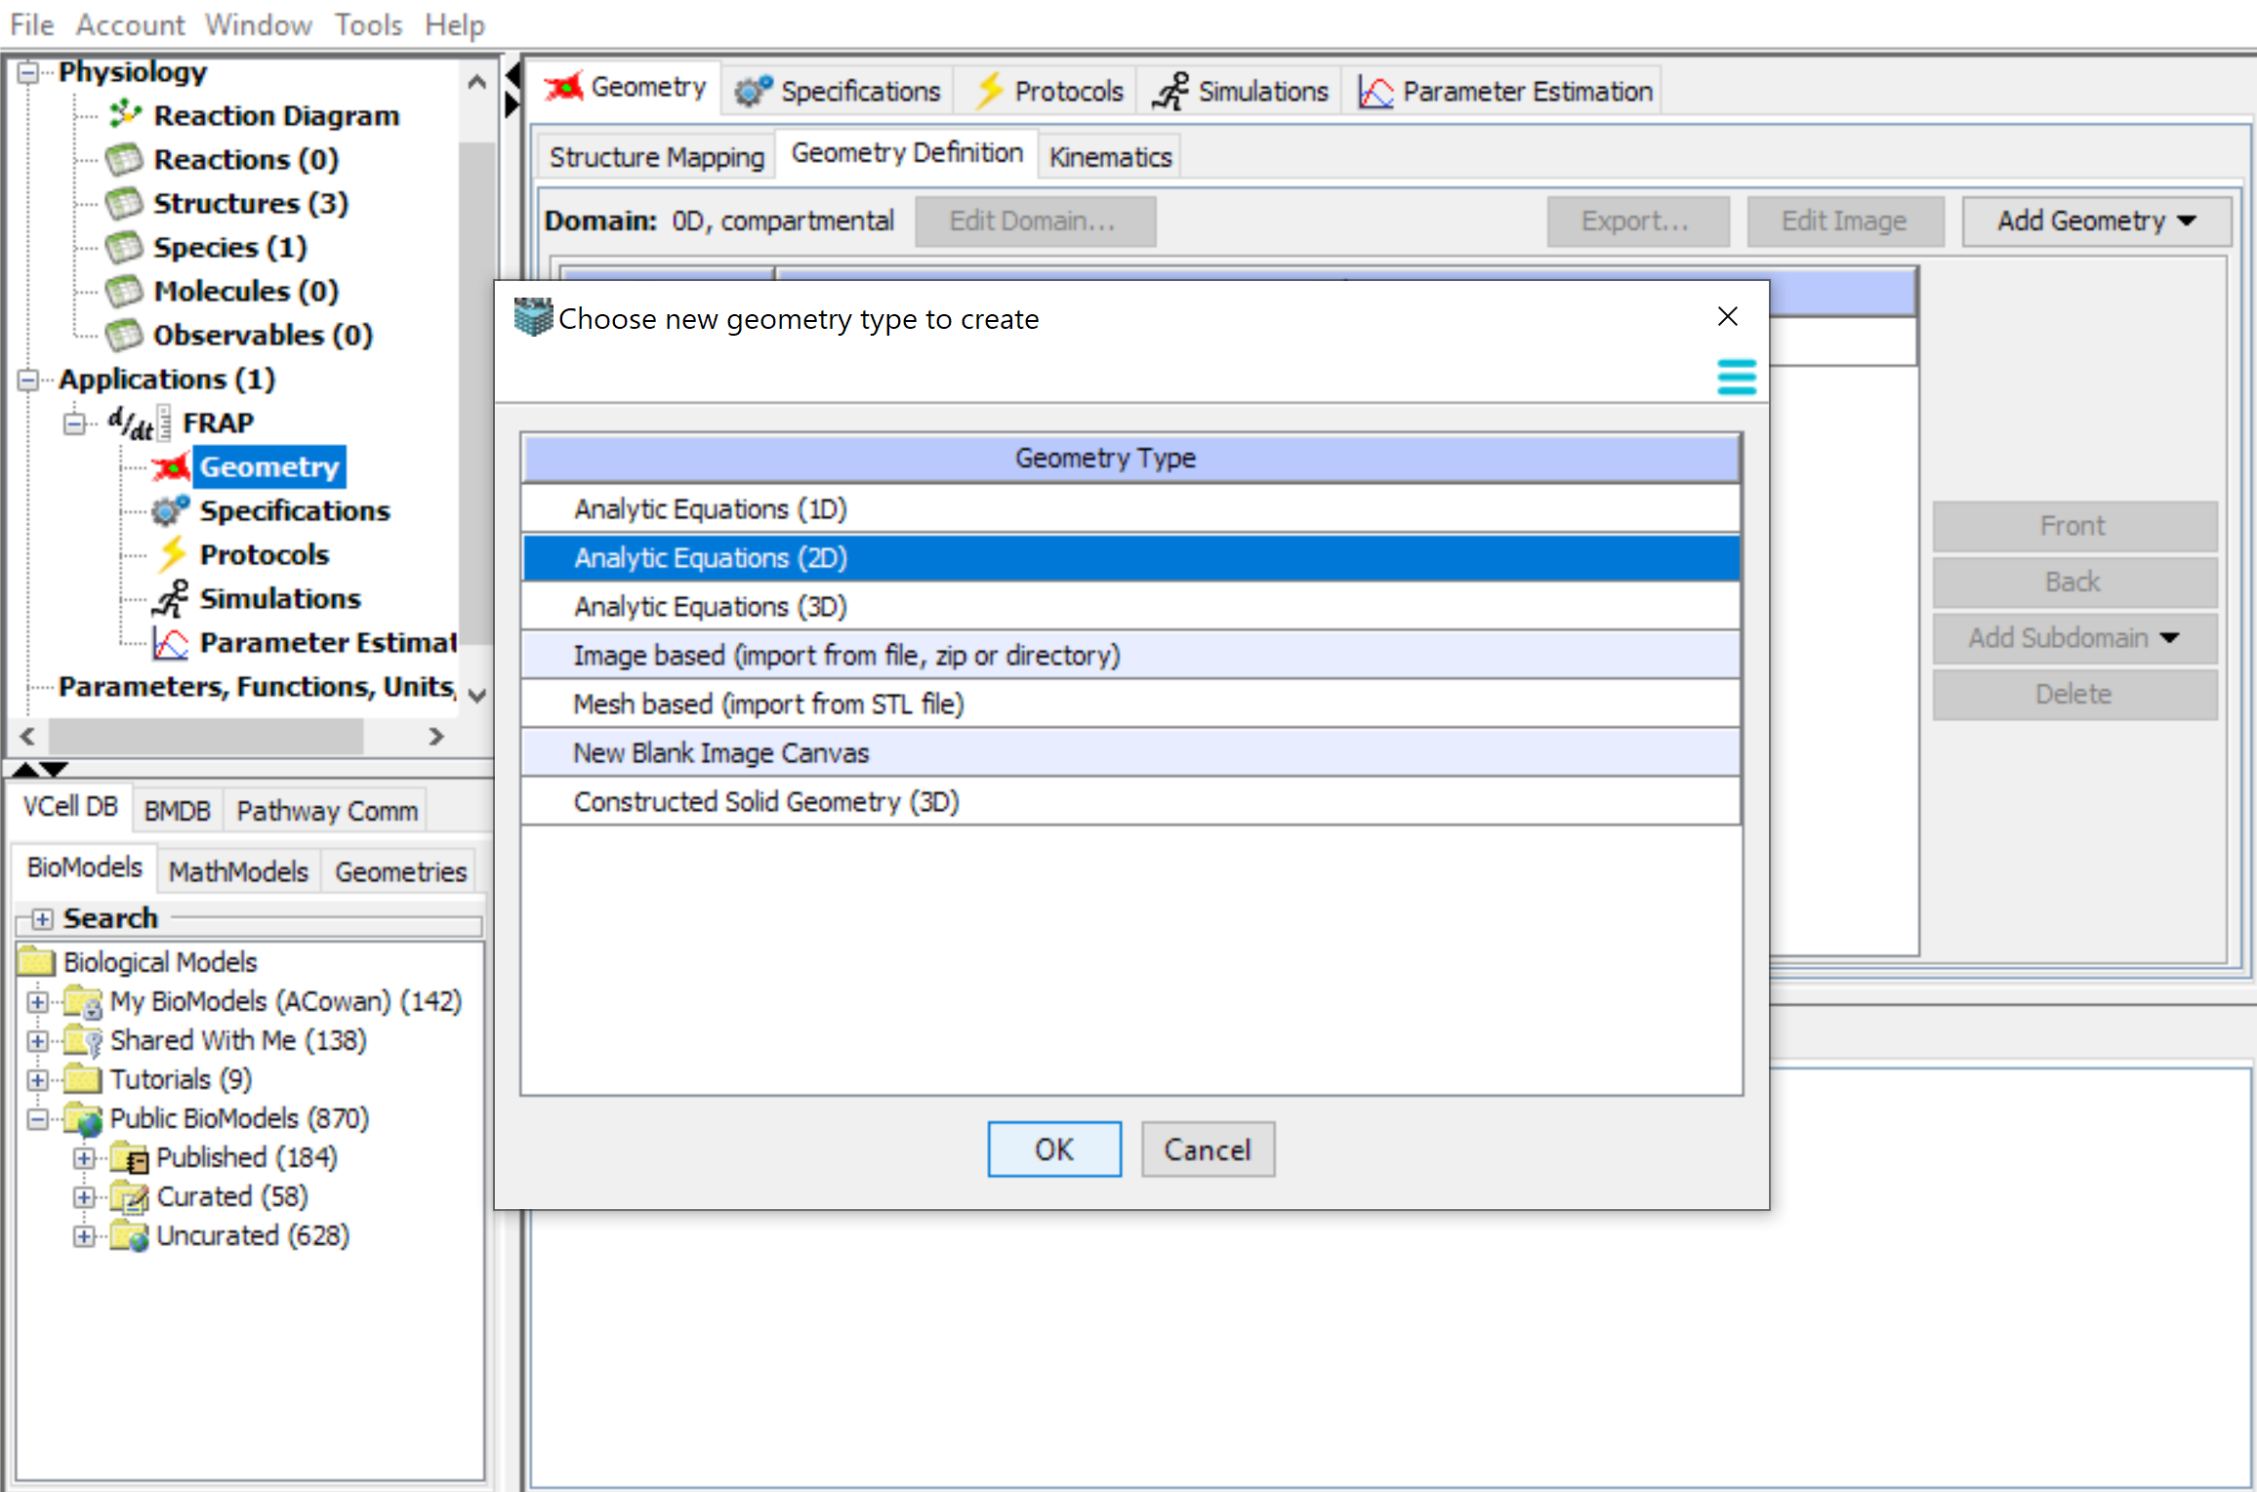
Click “Analytic Equations (2D)” > “OK”.
Note: Only 2D geometries can be used with the current Moving Boundary solver. The solver cannot be used with 3D geometries.

Slide 26
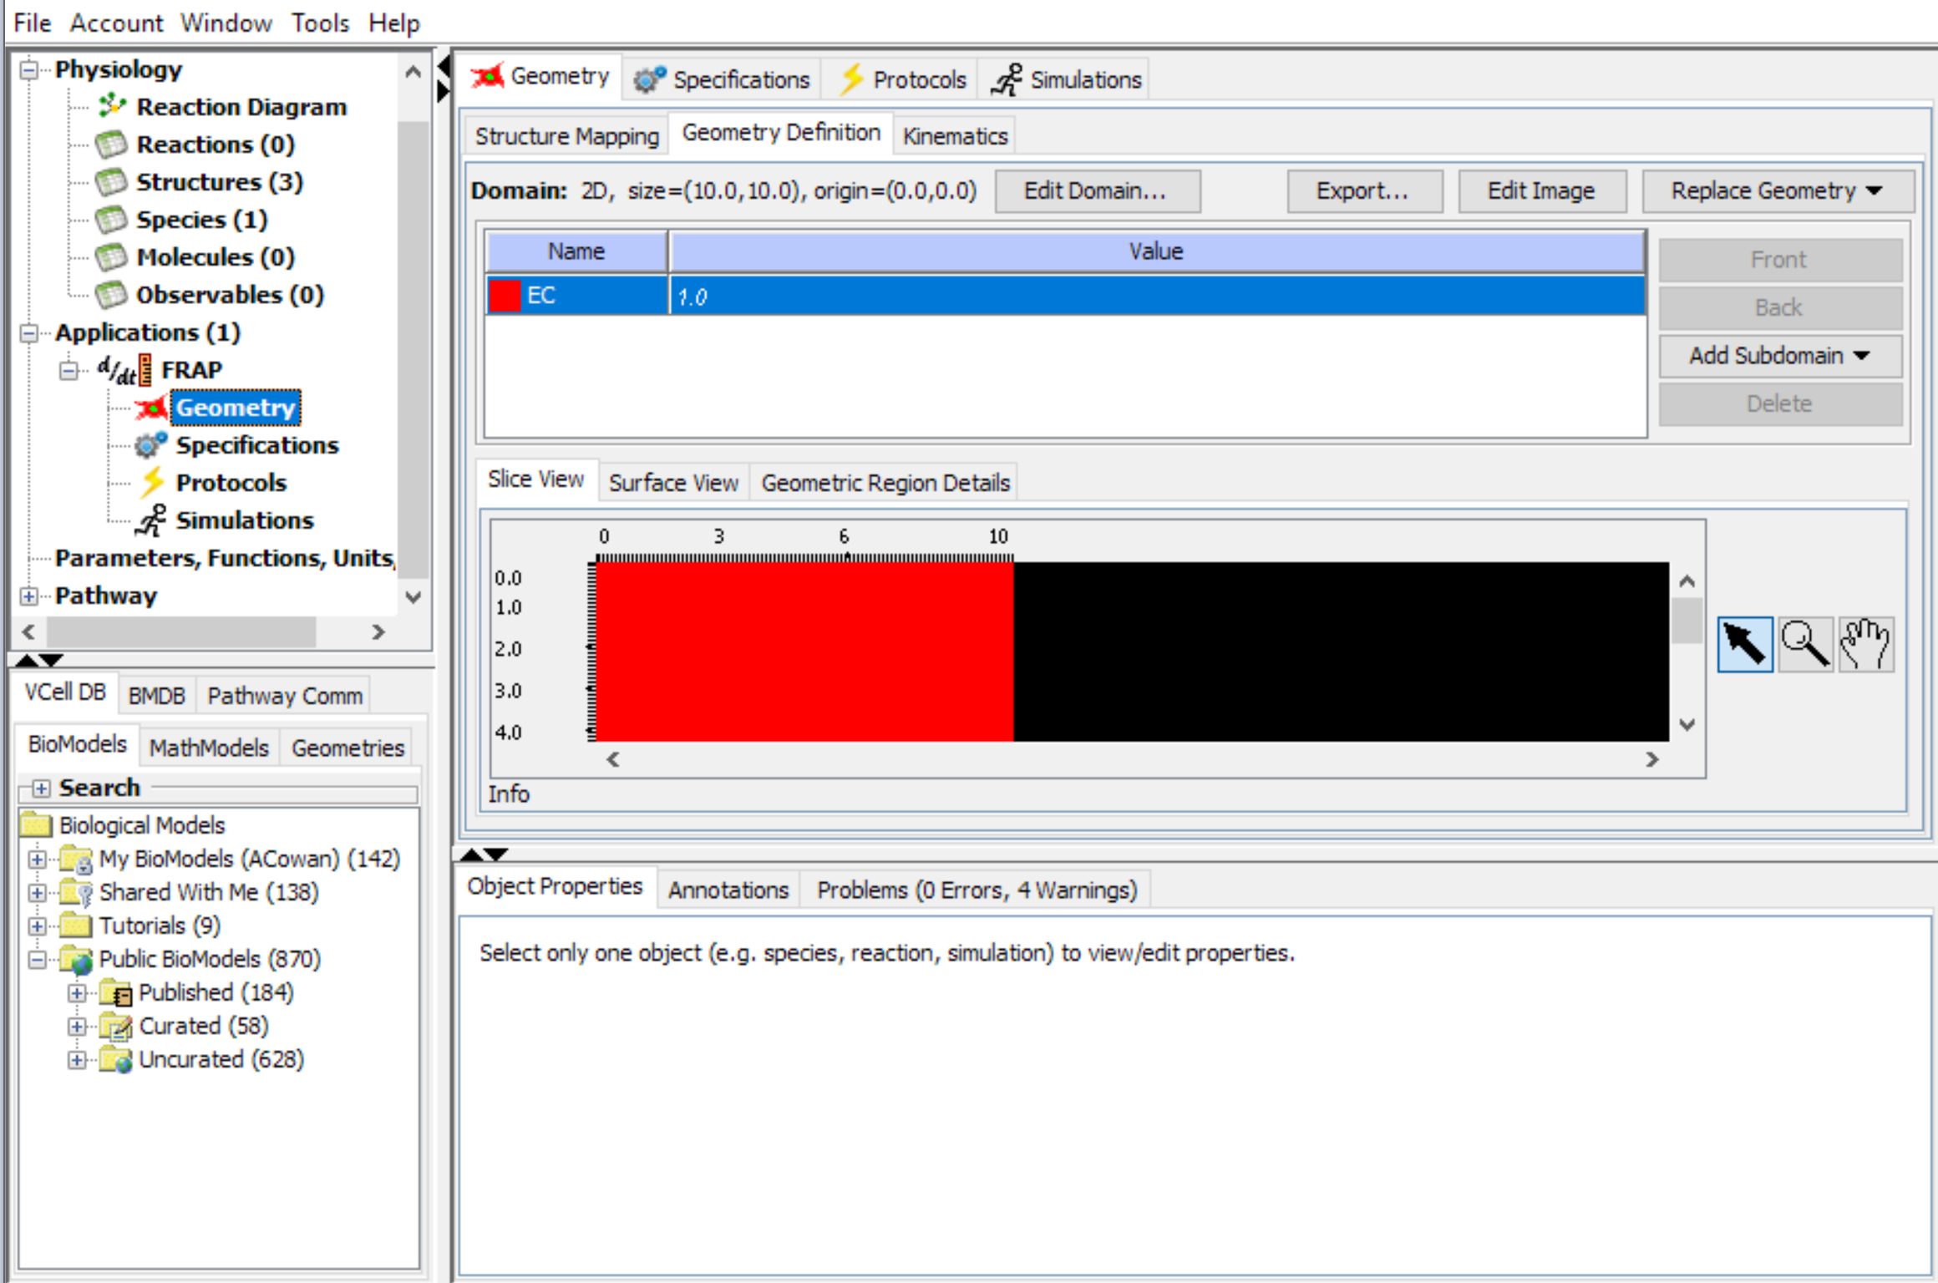
Double click in the domain name to change the name to “EC” and then use Enter to finalize

Slide 27
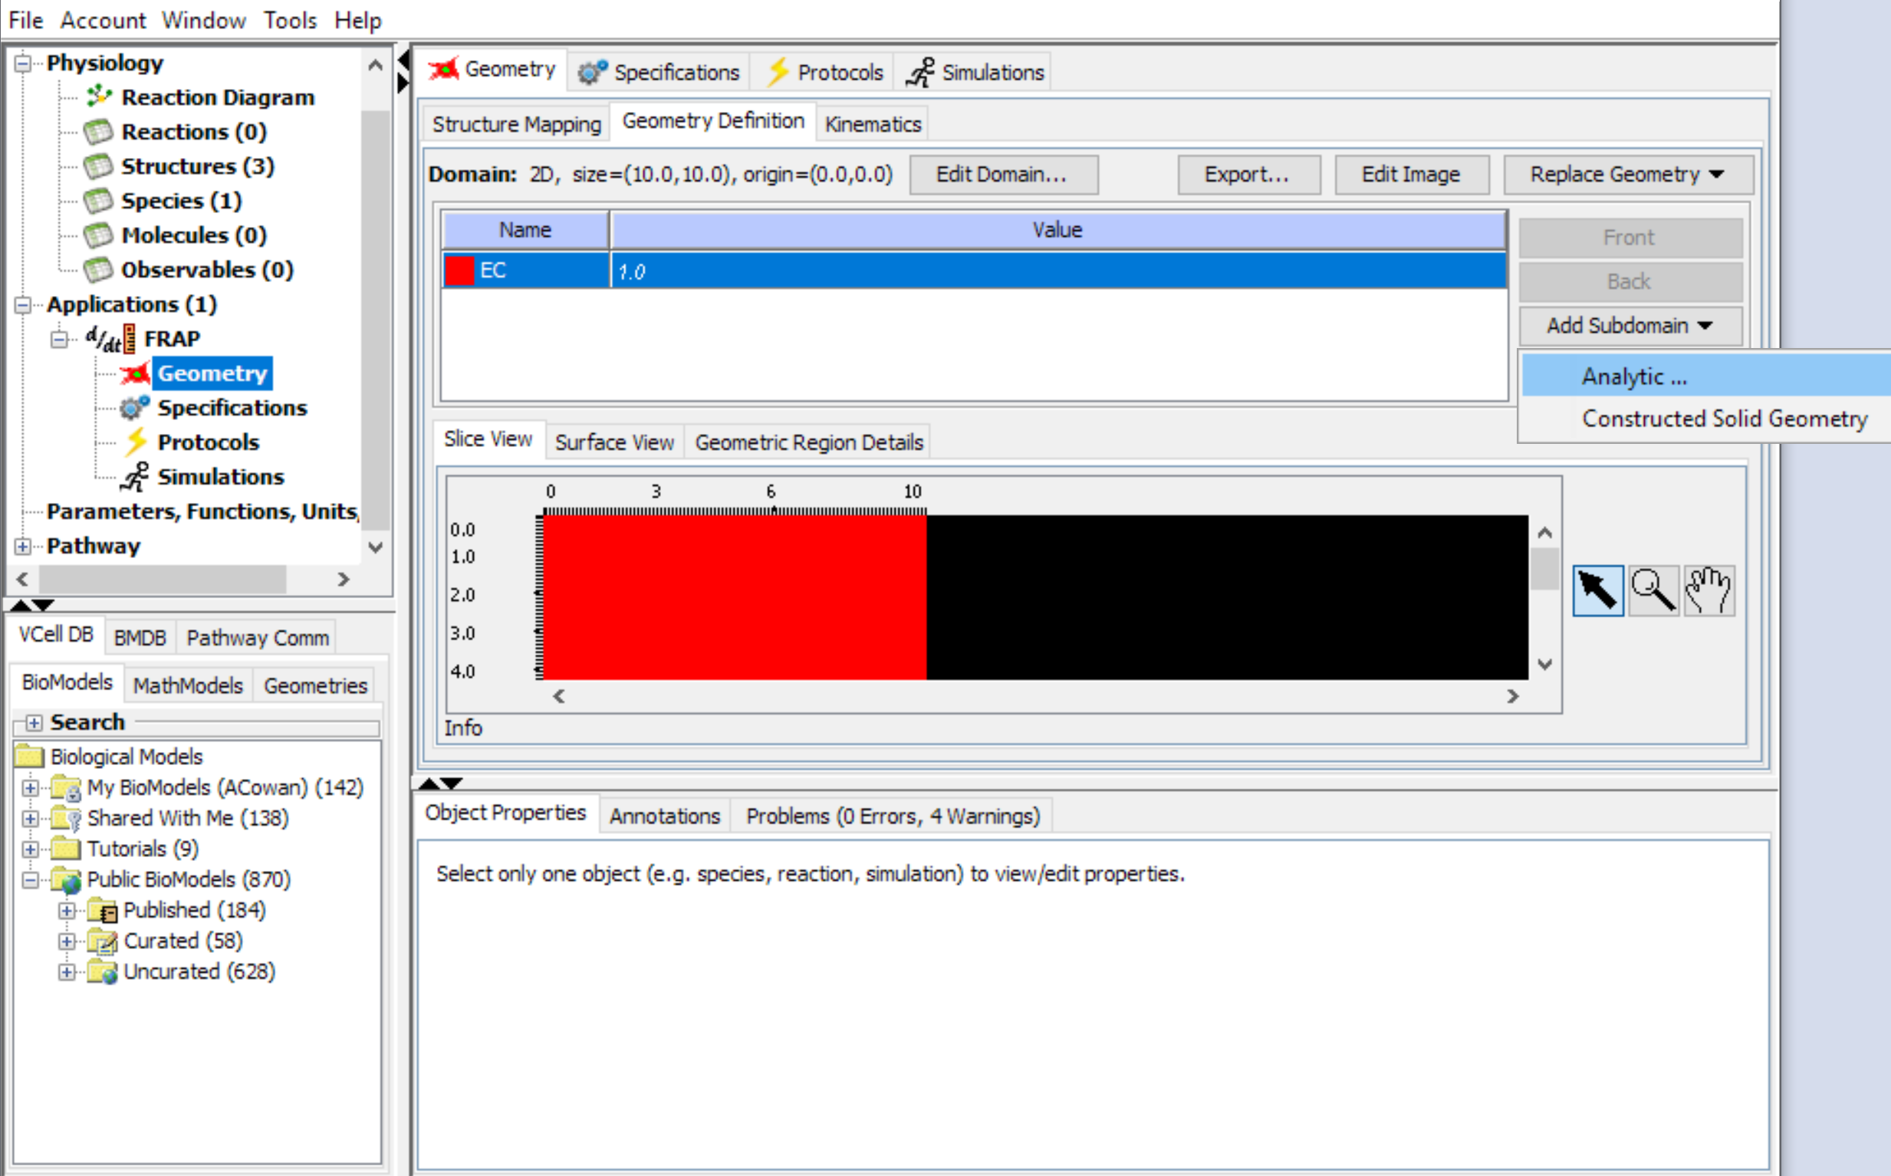
Select “Add Subdomain” > “Analytic”.

Slide 28
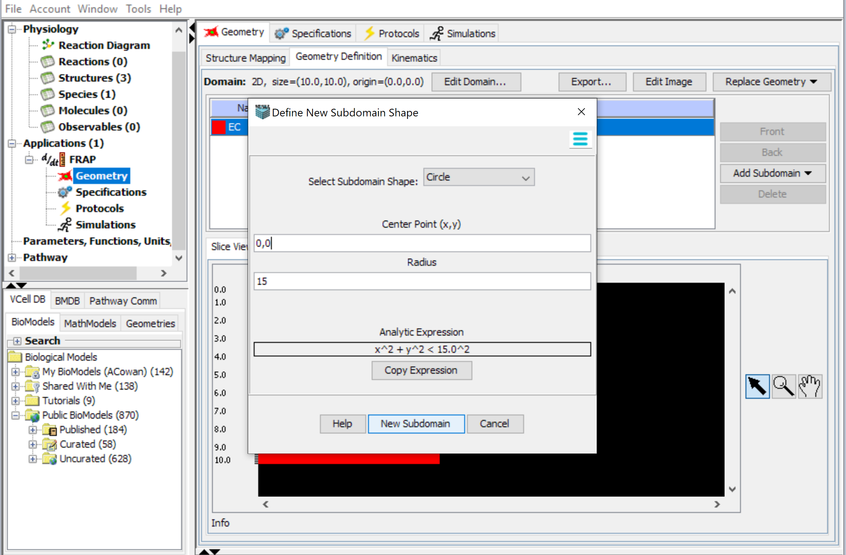
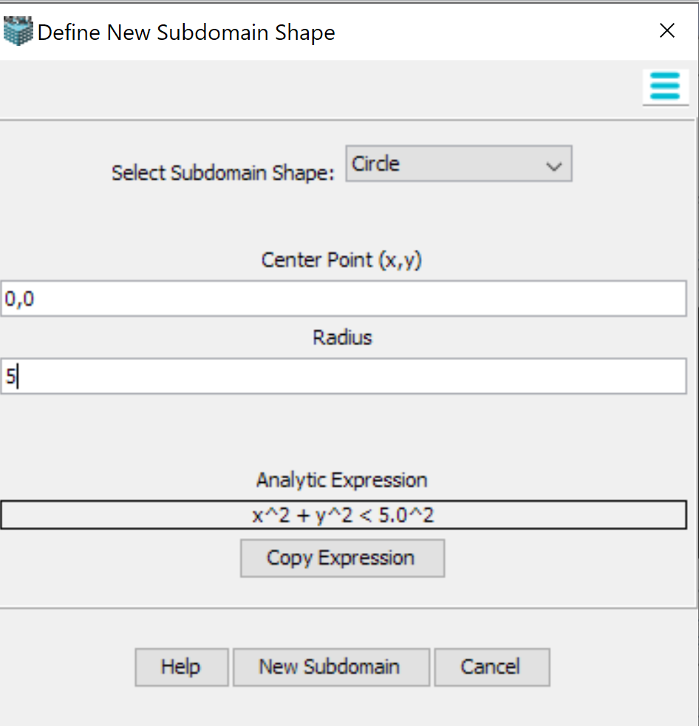
Select Circle from the drop-down menu for the Shape and enter 0,0 for the Center Point and 5 for the radius. This will create a circle10 µm in diameter centered on x = 0, y = 0 in the domain. Select “New SubDomain to add to your geometry domain
Note: You can also use the Copy Expression function if you have already created a subdomain, or simply write the expression in the domain specification
Note: Use the up/down arrows to expand the view of the geometry to better visualize the subdomains

Slide 29
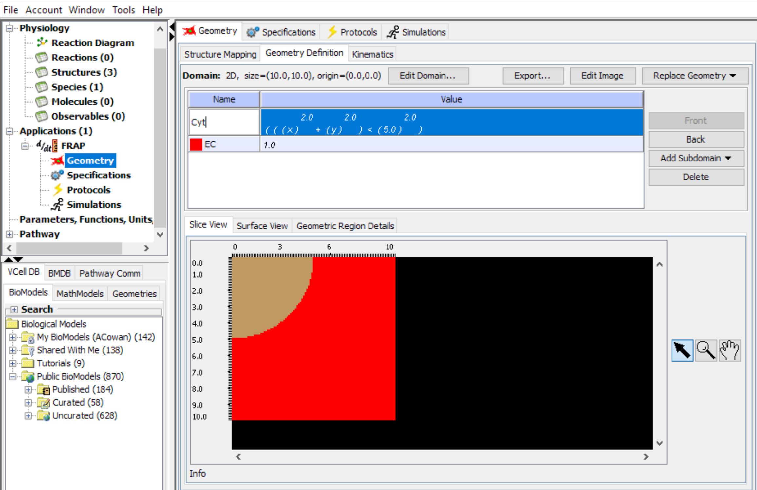
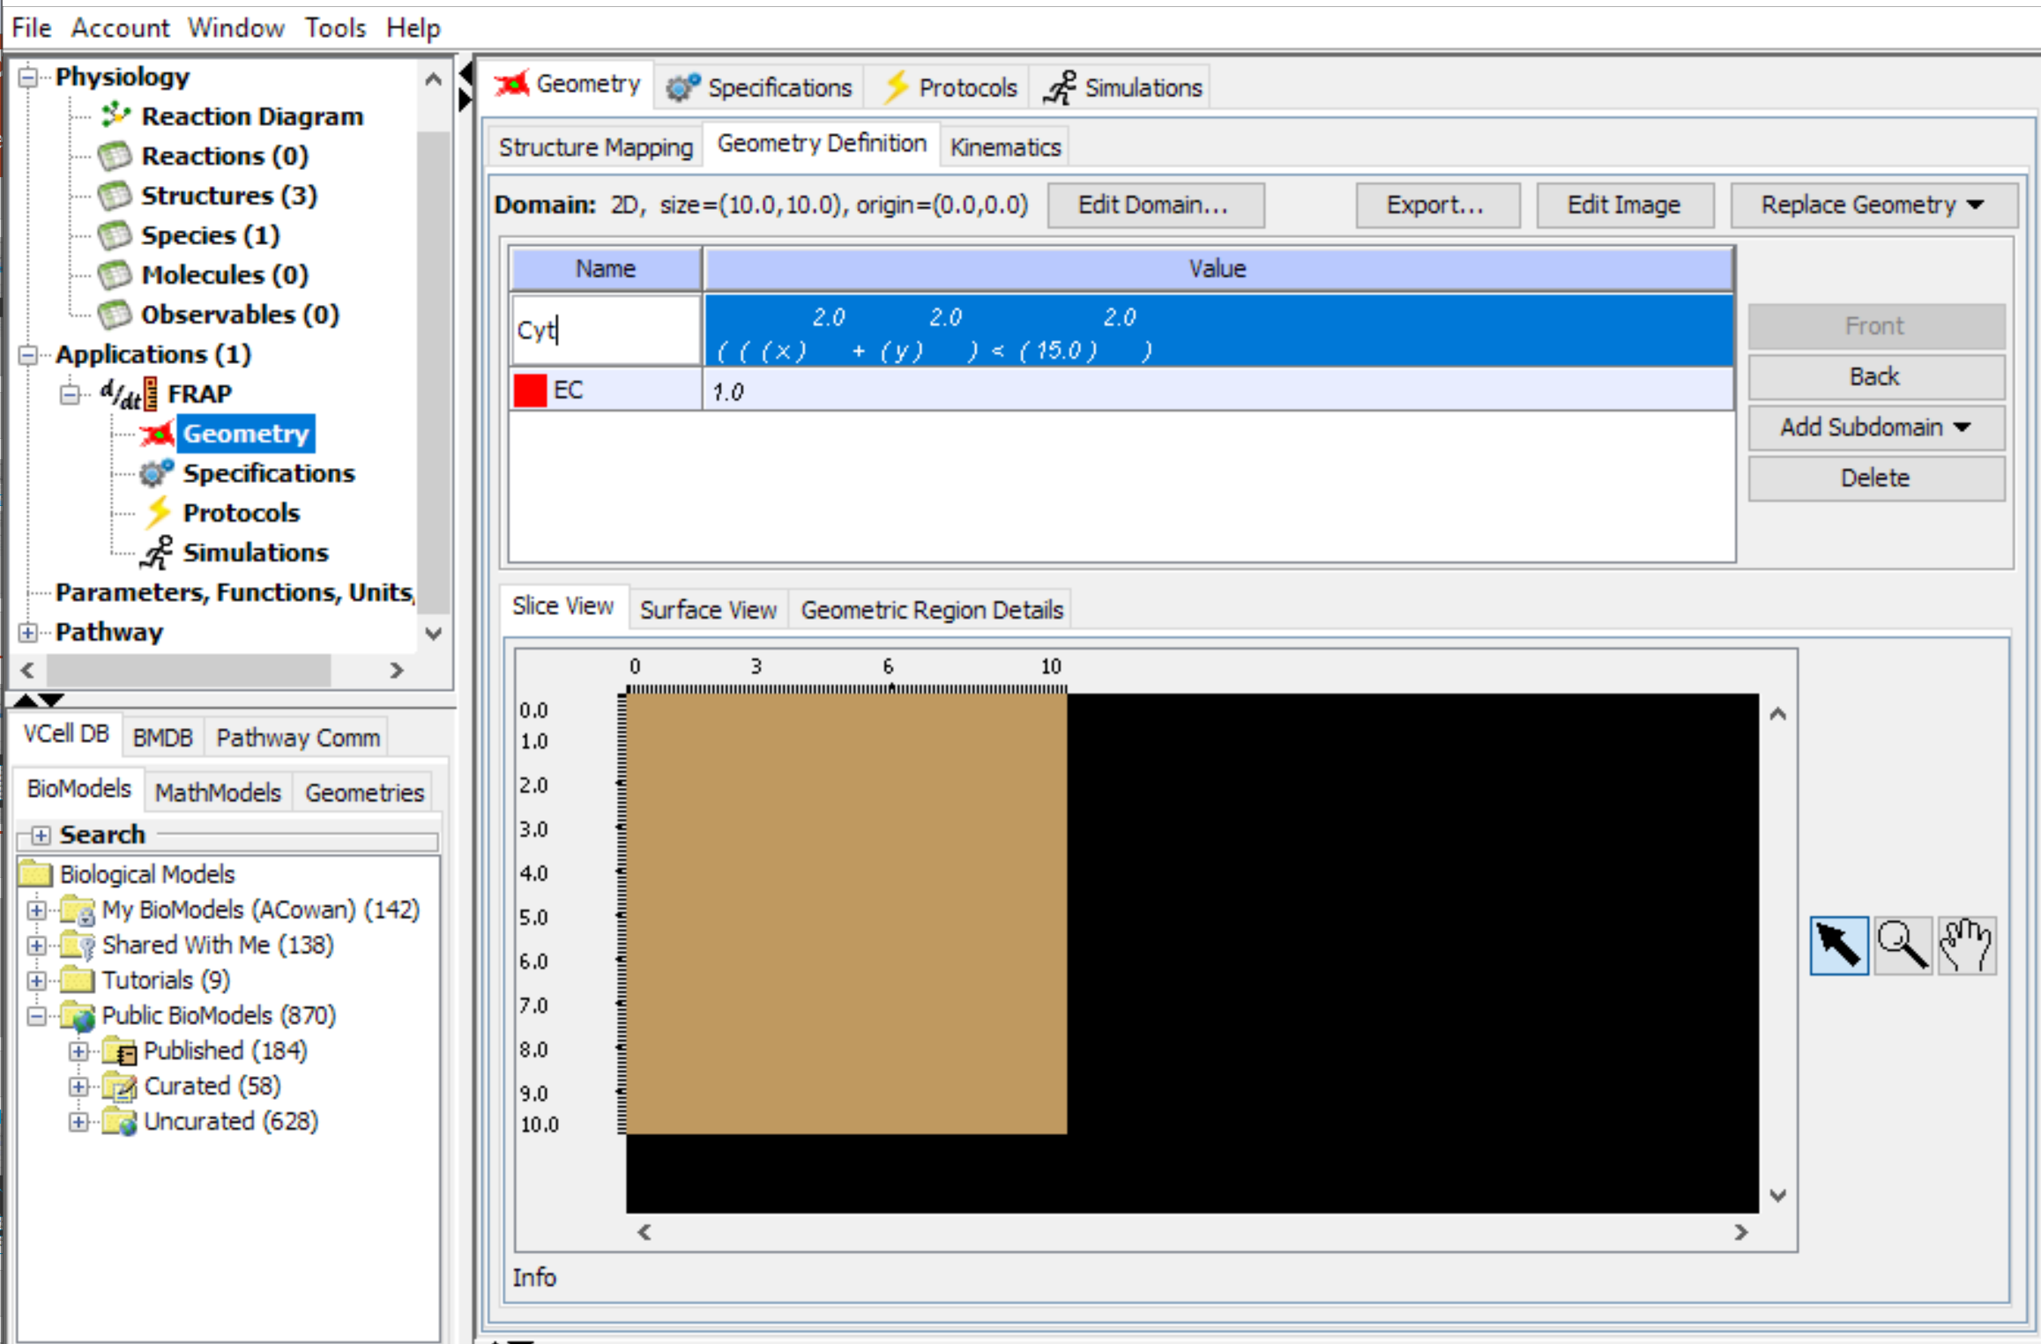
Double click the Name for the new domain and rename as “Cyt”. Use Enter to finalize the new name.
You will notice that the new Subdomain (shown in brown) is not centered and takes up most of the entire computational domain (defined by default as a 10µm square). You will next use the Edit Domain function to adjust the size of the computational domain.

Slide 30
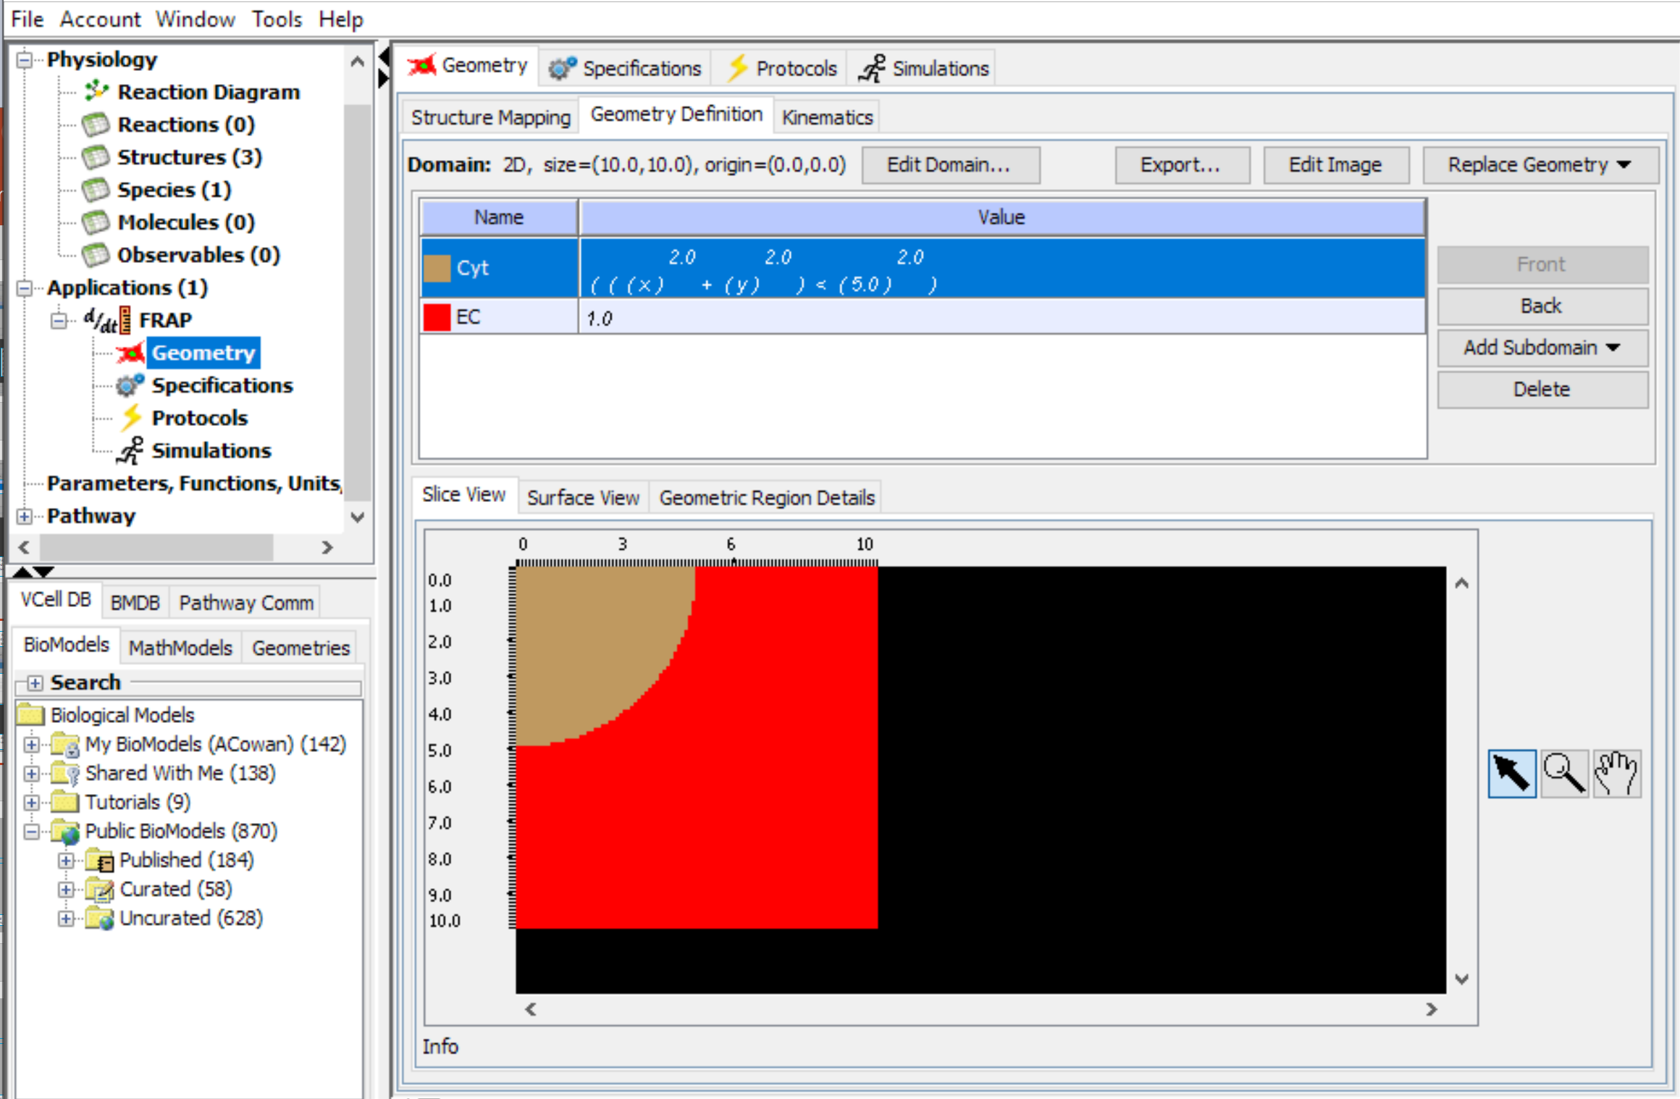
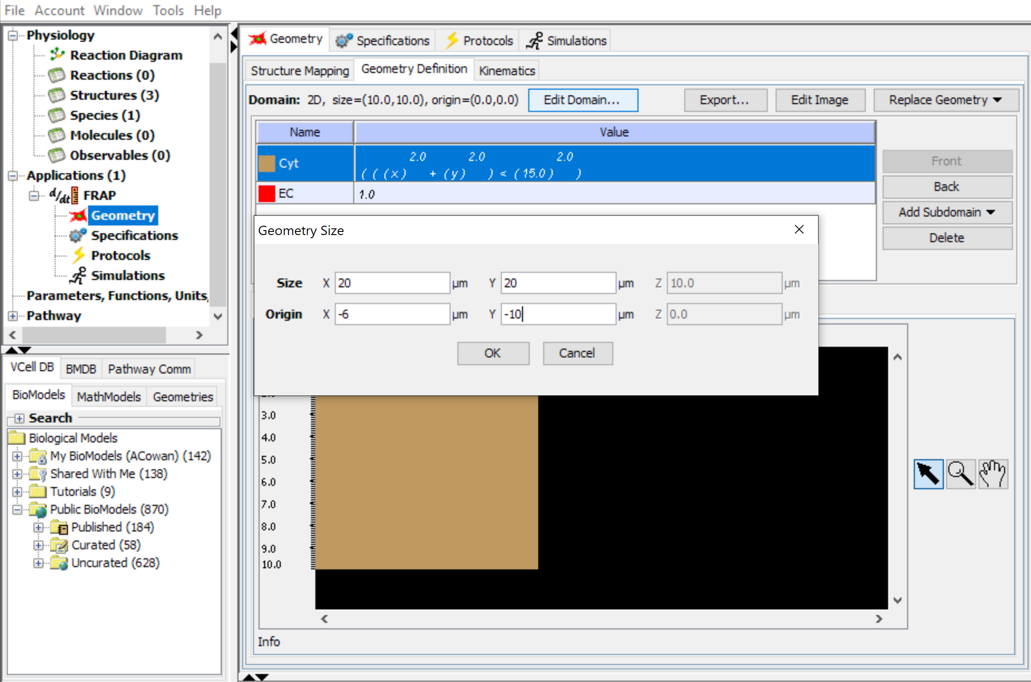
Select “Edit Domain” to adjust the overall size of the computational domain. For this tutorial, the extent of the domain should be 20 um in x and y, and place the origin at -6 in X and -10 in y.
,
Note: Because the Cyt subdomain is a circle centered at 0.0 in the domain, the circle will start at the left edge of the domain, giving it room to move across the domain during the simulation.

Slide 31
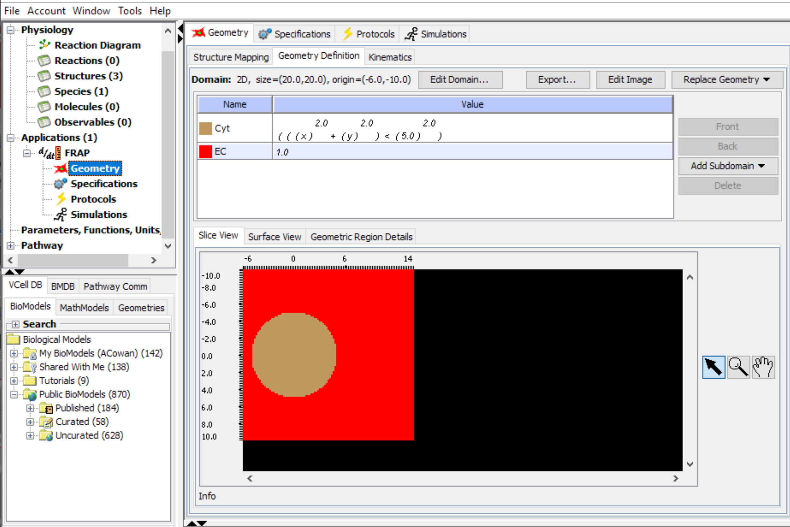
The geometry now defines a circular “Cyt” domain at the left boundary of a square “EC” domain. Next we will define the motion of the subdomain within the geometry.

Slide 32
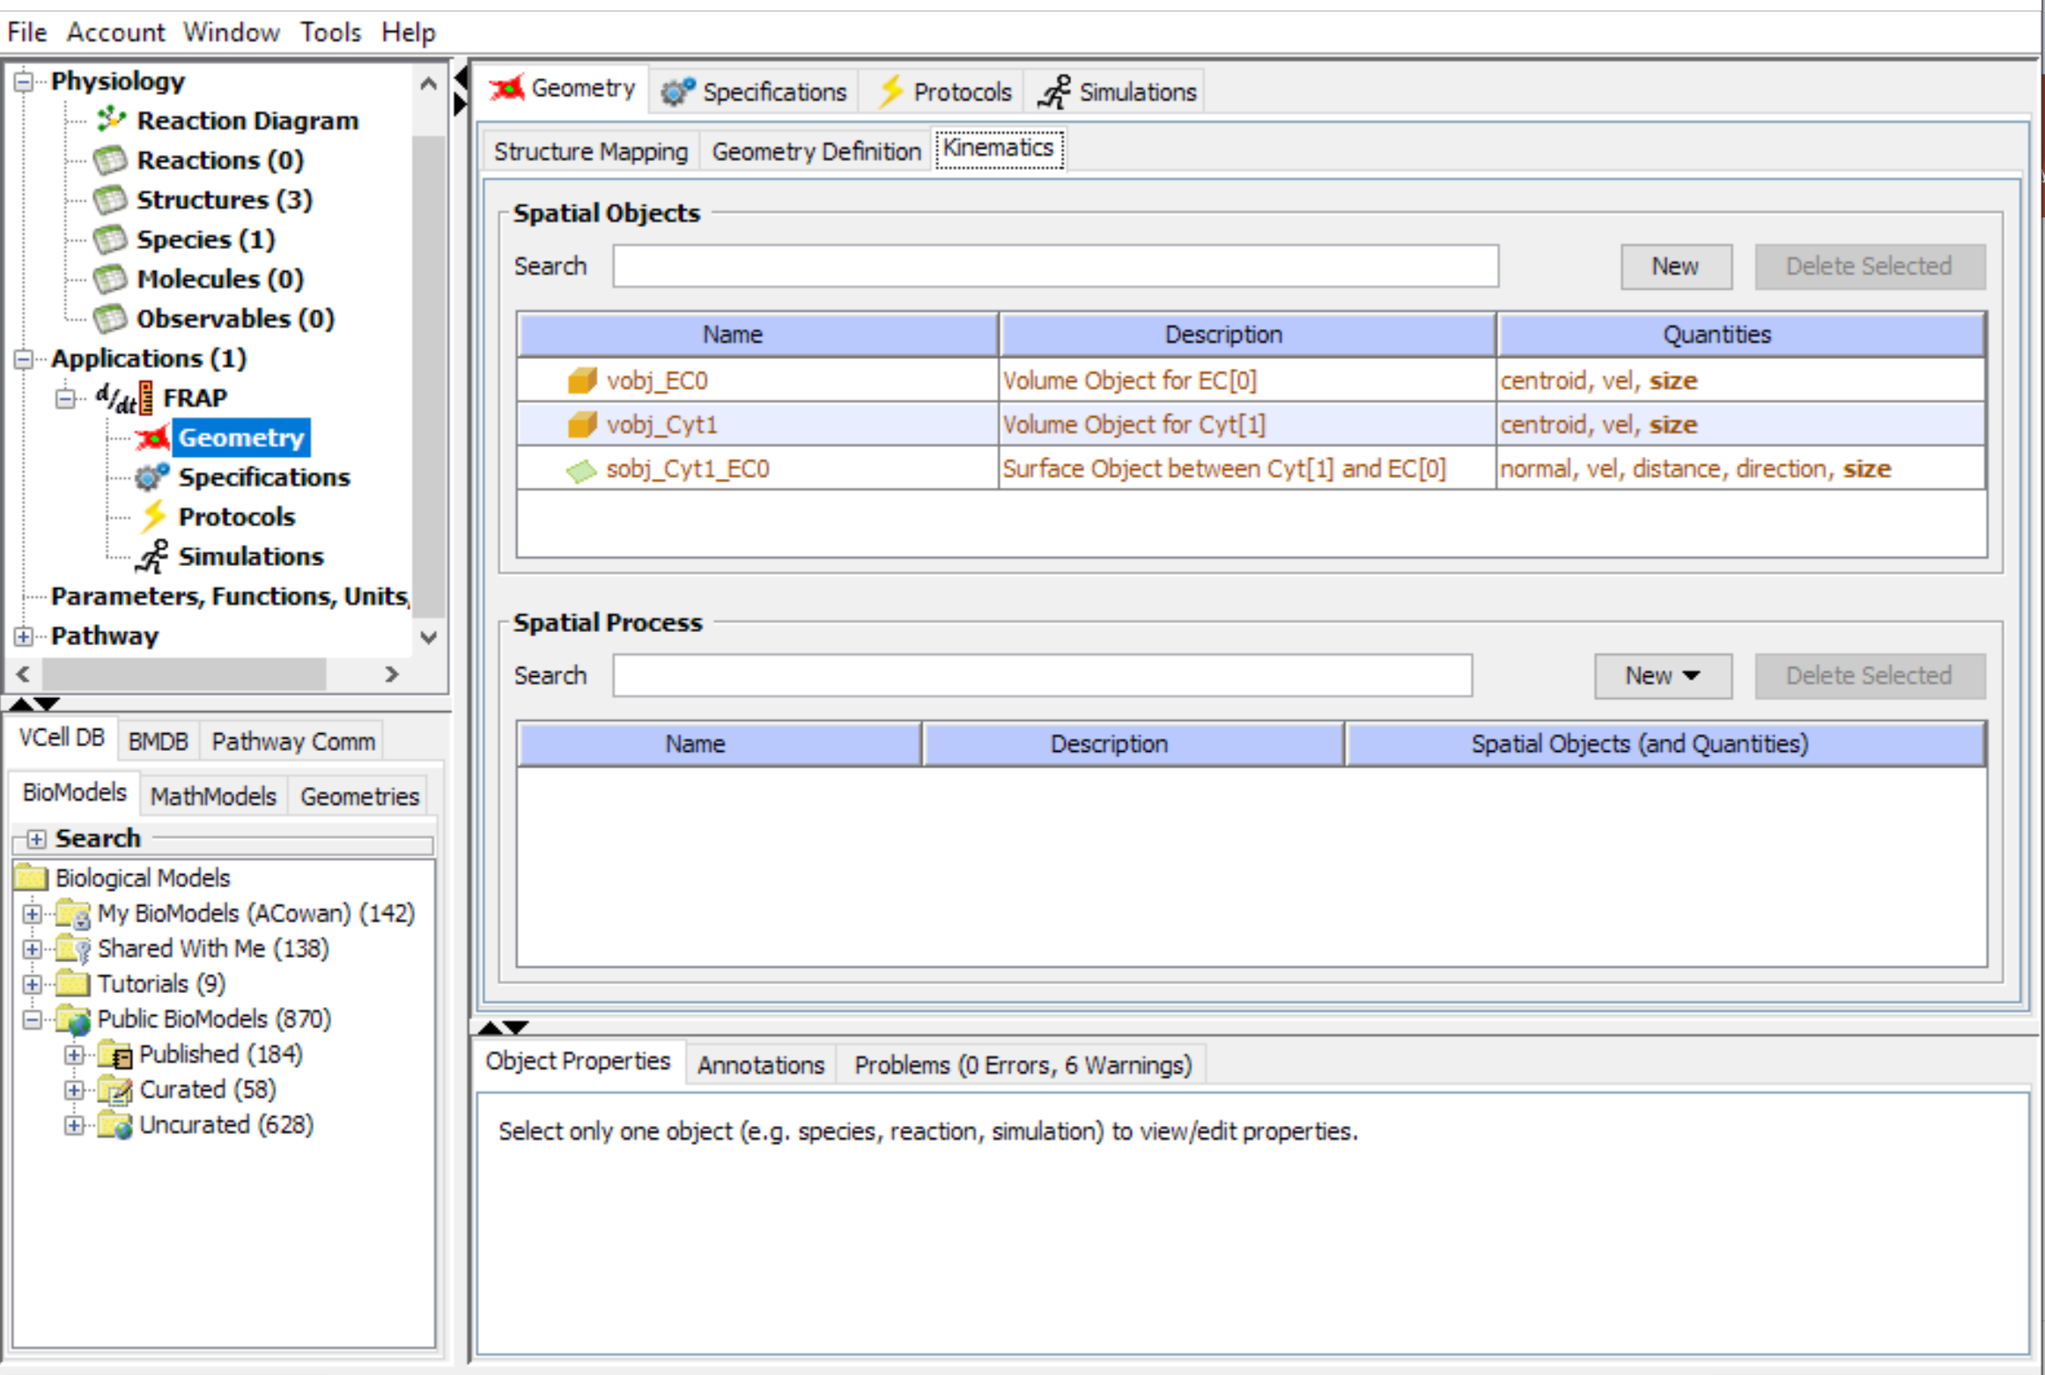
Select the “Kinematics” Tab in the Geometry workspace

Slide 33
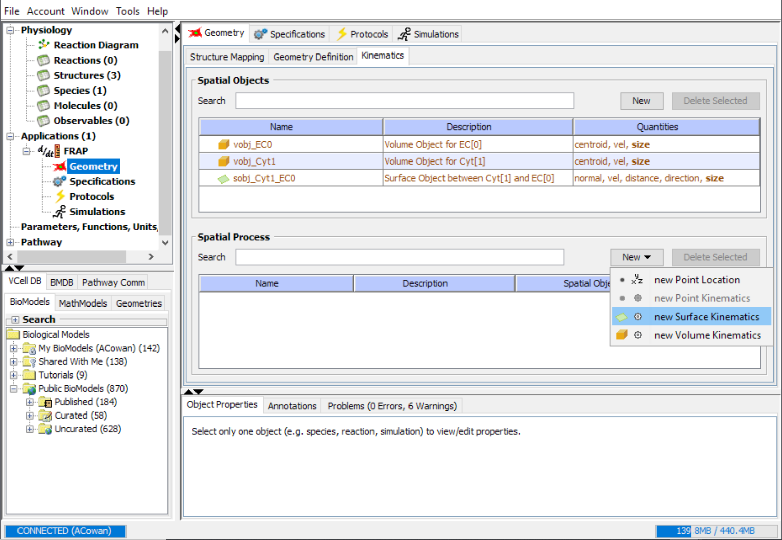
In the Spatial Process window, select “New”> “new Surface Kinematics.”

Slide 34
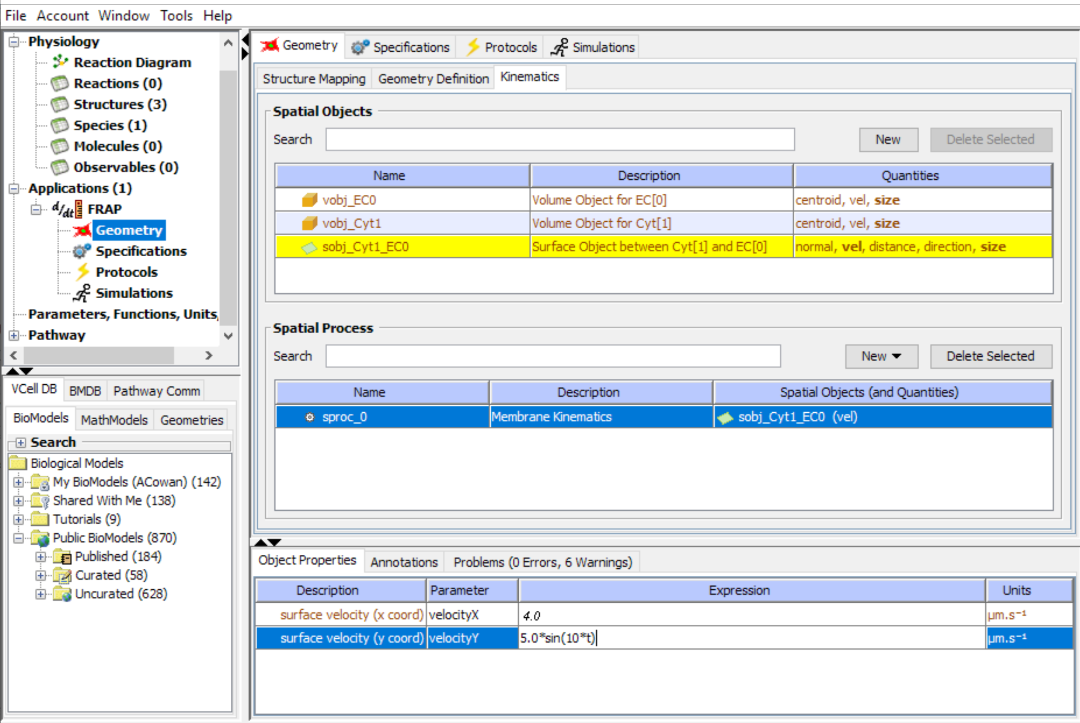
Click on the Spatial Process to select that process
Write in an expression to define the velocity in x and y. For this example, x is a constant velocity of 4 µm/s. Velocity in y is described as a sine function that varies with time (5*sin(10*t) µm/s, so the object will move up and down as well as to the right during the simulation.

Slide 35
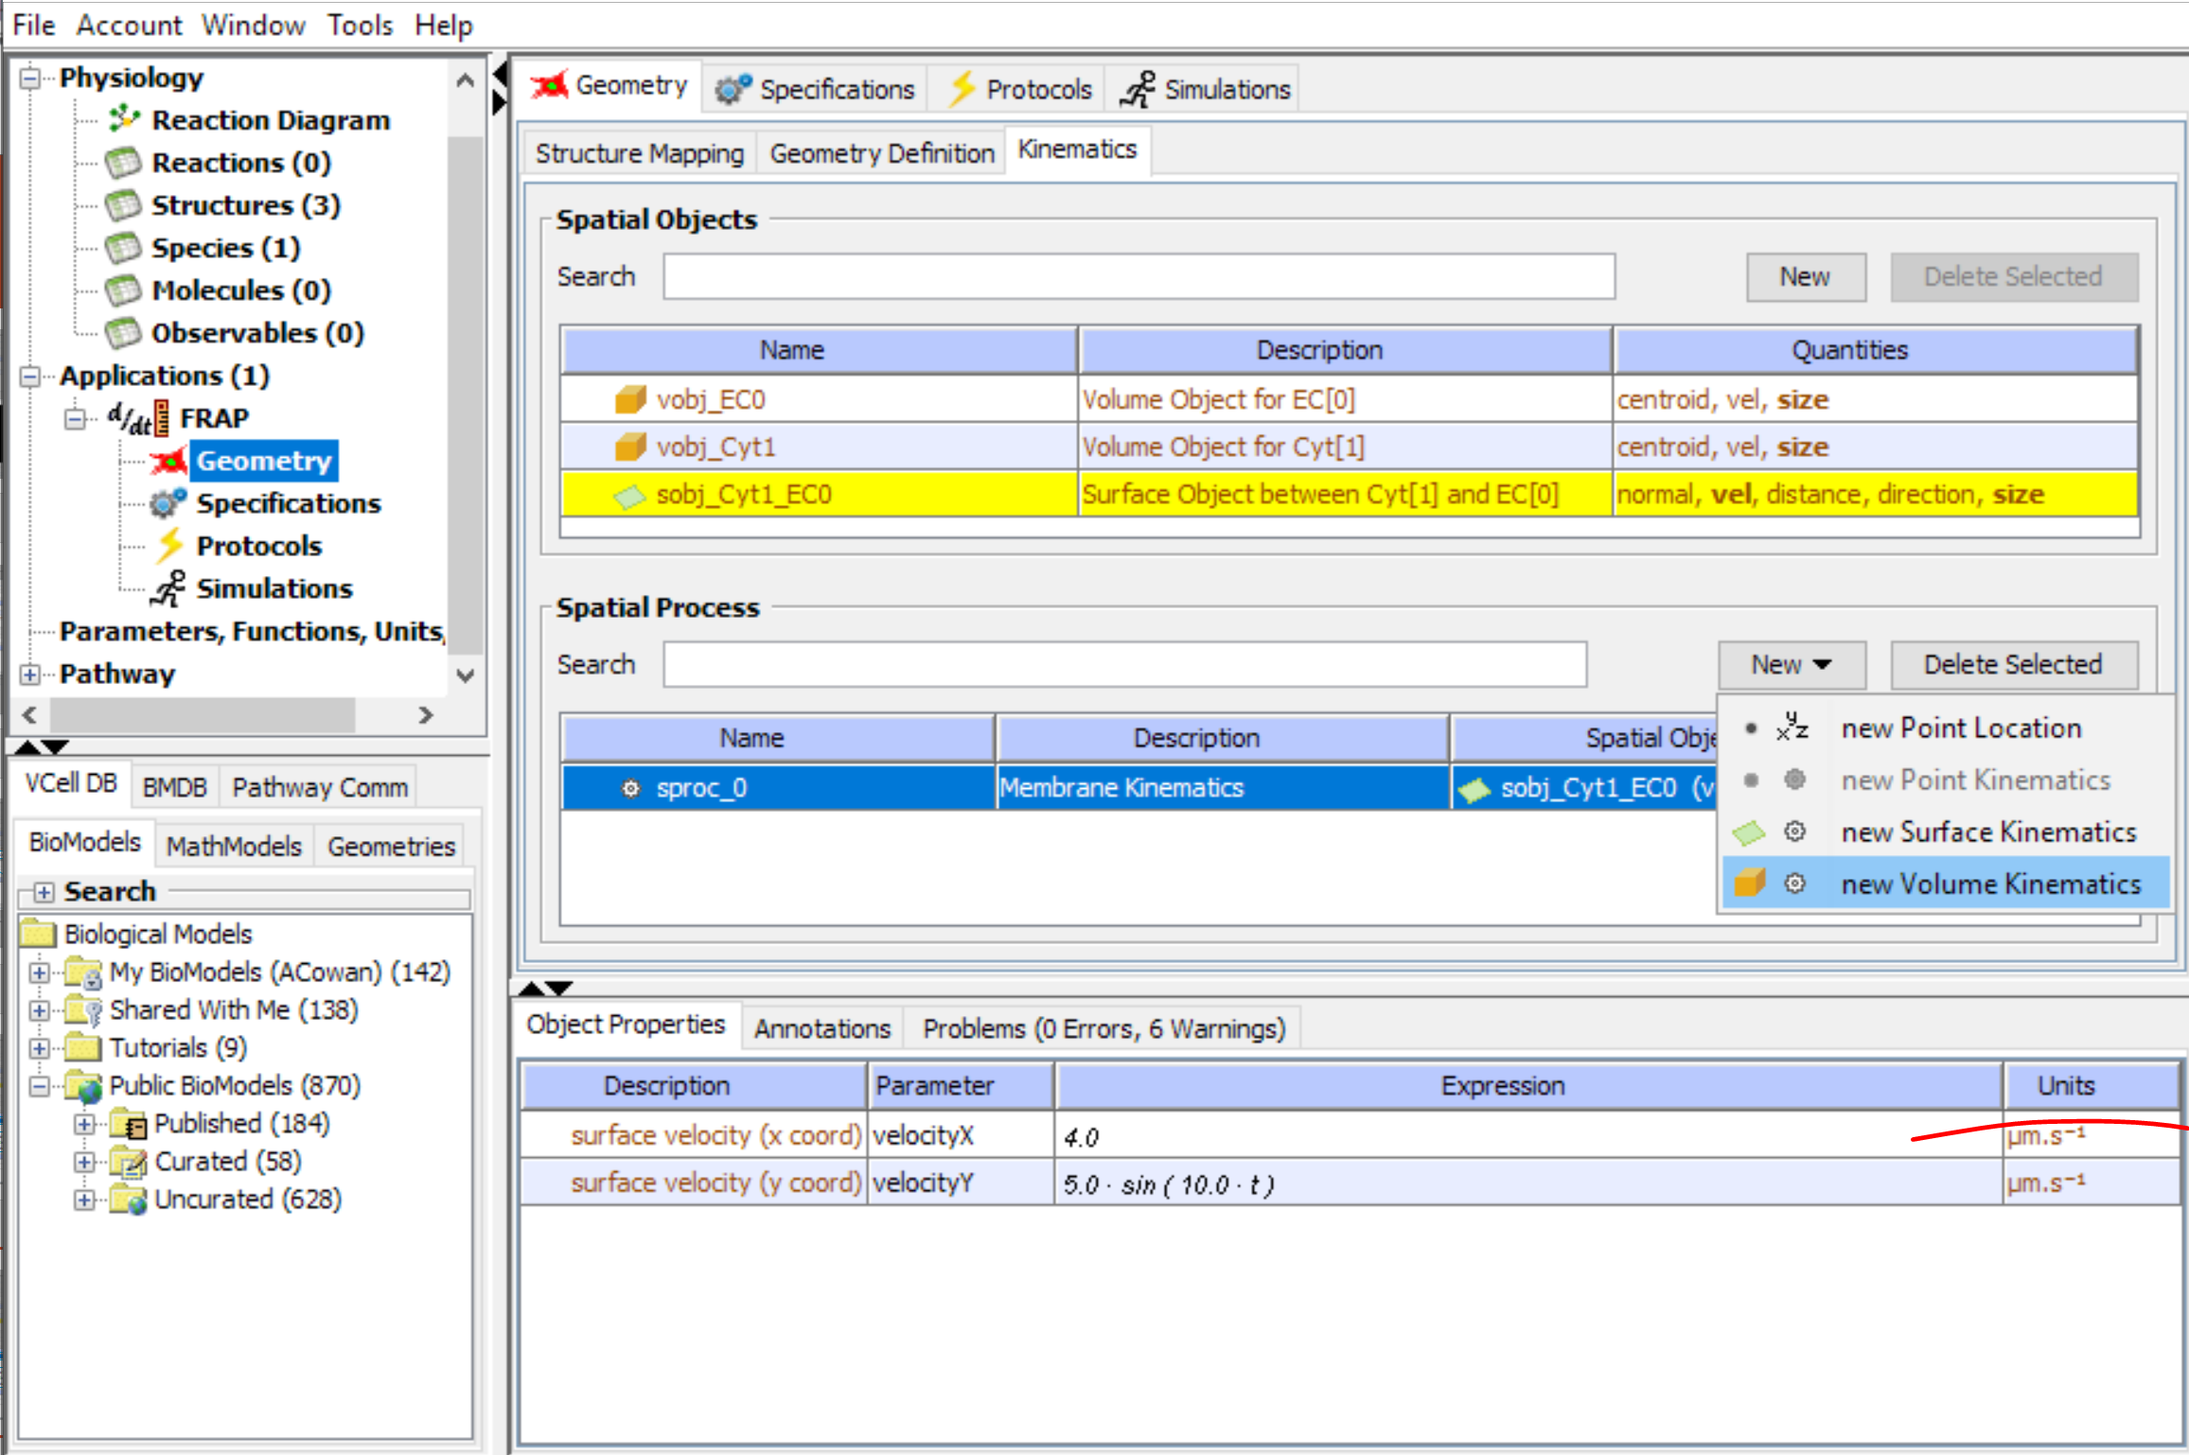
In the Spatial Process window, select “New”> “new Volume Kinematics.”

Slide 36
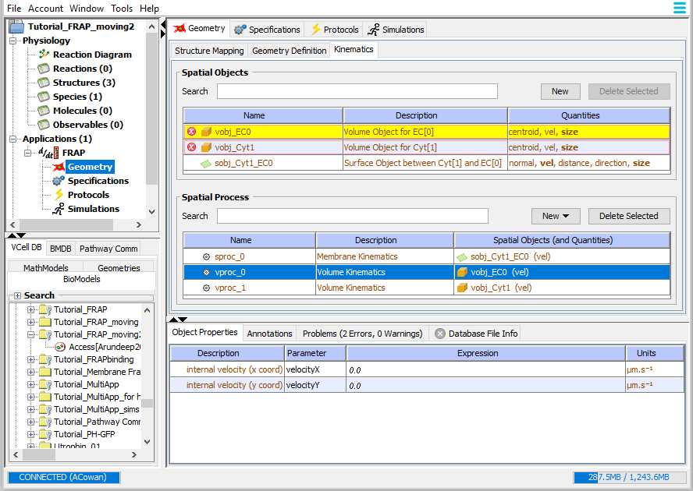
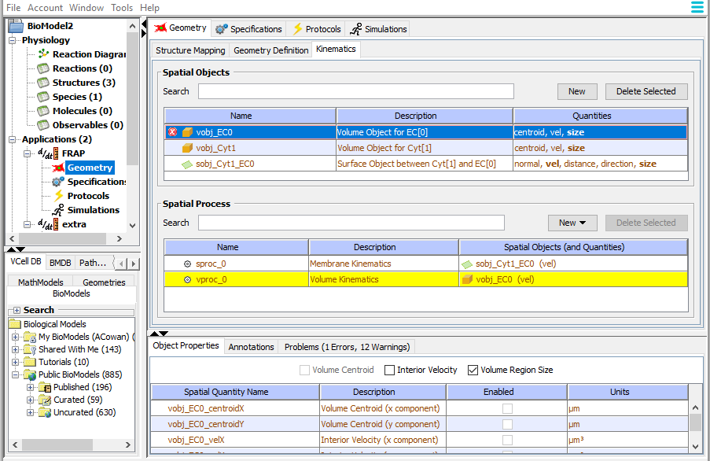
The software by default will create volume spatial processes in the order of volumes shown in the top spatial volume table. Continue to create new processes until you create a process for the volume object you want; in this case, the vobj_Cyt1 (cytosol). Select the process you do not want, and “Delete Selected”

Slide 37
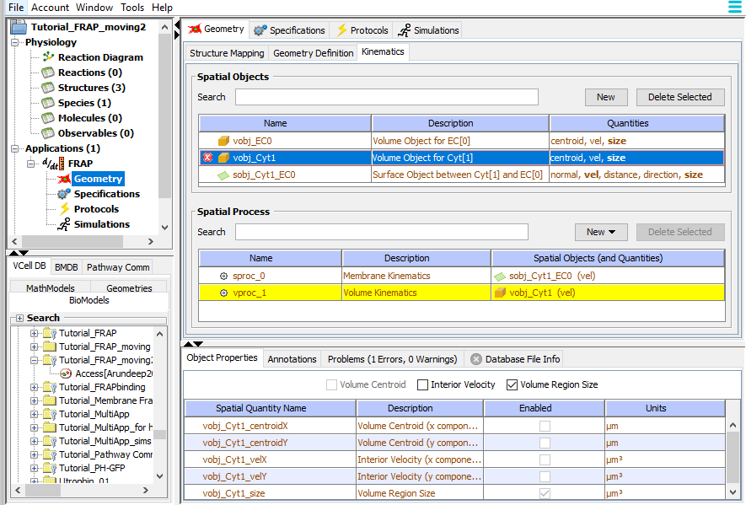
When a new Spatial Process for a volume object is created, an error is created associated with the Spatial Object because it has not been enabled to have an Interior Velocity. You must go back and select that Spatial Object.
Enable the Interior Velocity using the check box in the Object Properties Window

Slide 38
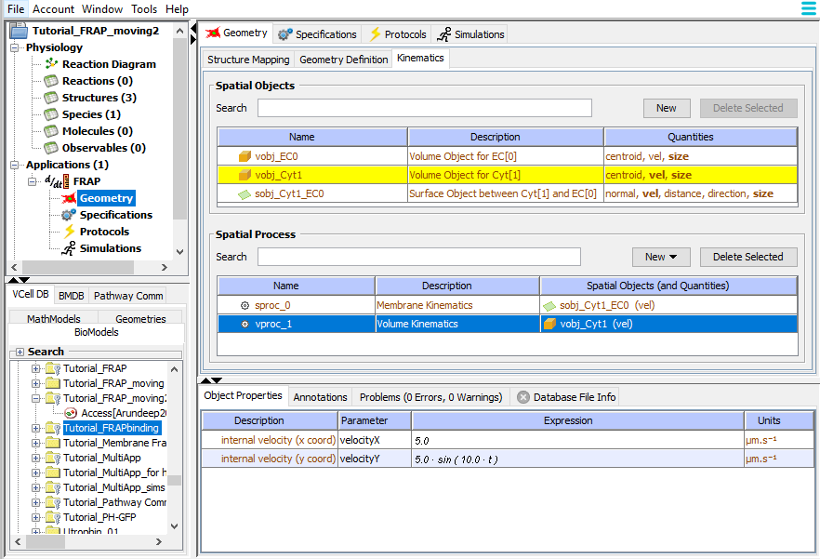
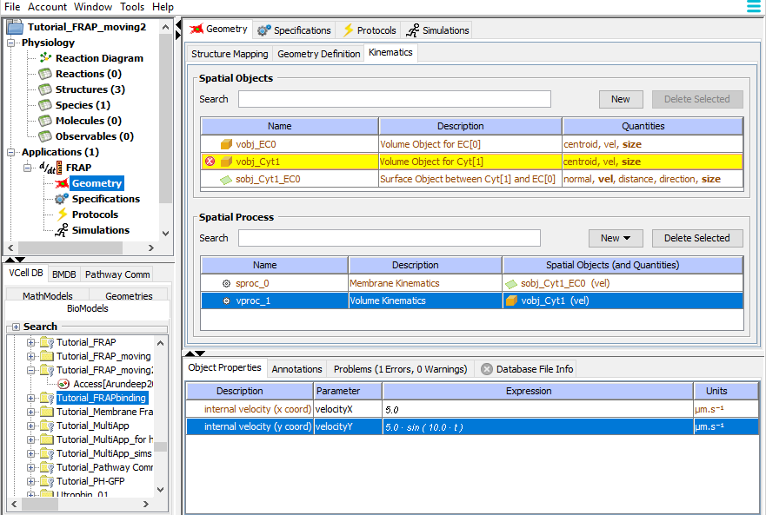
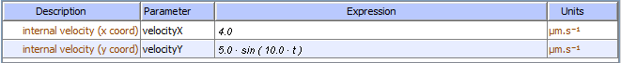
Click on the Volume Process to select that process.
In this example the cytosol will move with the membrane, so the same functions are used to describe the x and y velocities

Slide 39
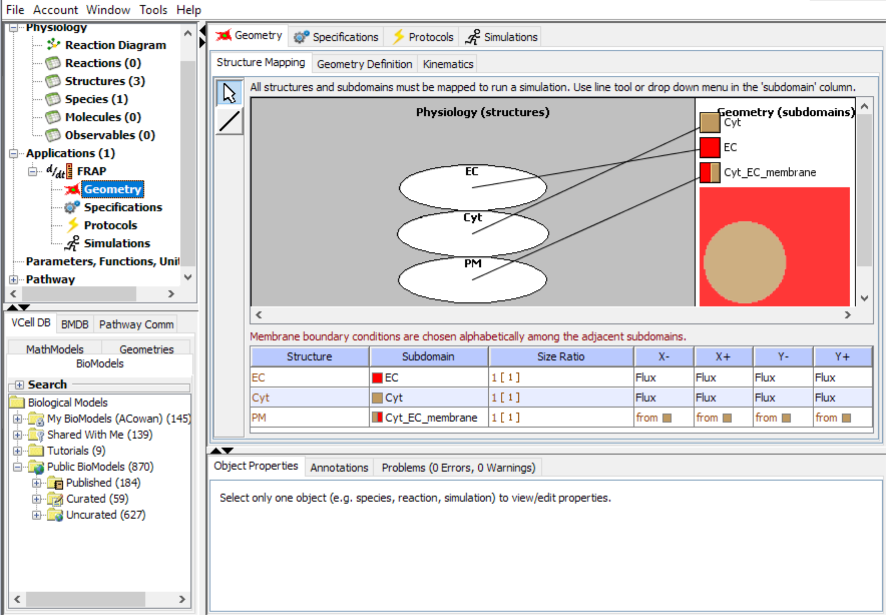
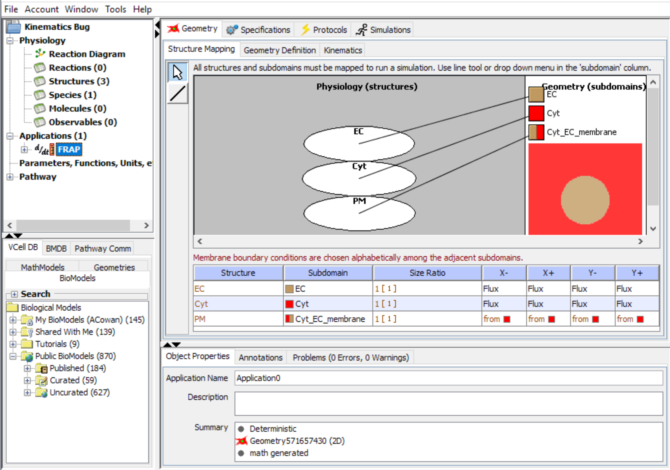
On the Geometry tab > Structure Mapping tab, use the line tool to link the physiology to the geometry. You must select the line tool each time and drag your cursor from a structure to its corresponding subdomain.

